Slide 1
CCBE CONFERENCE: TRAINING OF LAWYERS, CHALLENGES AND OPPORTUNITIES WIFI L42 Pass: allfornet

Slide 2
AGENDA
Opening remarks
First Plenary: Future soft skills
Second Plenary: Innovative learning methods
Final Plenary: Introduction to the European Training Platform
(Coffee break of 30’)
Conclusions
Workshops
(Lunch break)
(Coffee break of 30’)

Slide 3
OPENING REMARKS
RUTHVEN GEMMEL WS, CCBE President
PIER GIOVANNI TRAVERSA, Chariman of the CCBE Training Committee
ANTOINE HENRY DE FRAHAN, Expert and co-founder of FrahanBlondé
PETER CSONKA, European Commission, DG Justice and Consumers

Slide 4
OPENING REMARKS
RUTHVEN GEMMEL WS
CCBE President

Slide 5
OPENING REMARKS
PIER GIOVANNI TRAVERSA
Chairman of the CCBE Training Committee

Slide 6
OPENING REMARKS
THE LAWYERS OF EUROPE : THE LEGAL MARKET TODAY, NEW TECHNOLOGIES AND NEW BUSINESS MODELS.
ANTOINE HENRY DE FRAHAN

Slide 7
The Future of Lawyers
The legal market today, new technologies,
and new business models
Antoine Henry de Frahan

Slide 8
Law Firms
Clients

Slide 9
Legal
Tech
Law Firms
Clients

Slide 10
Legal
Tech
Law Firms
Clients
New Players

Slide 11
Think strategy before innovation
1.

Slide 13
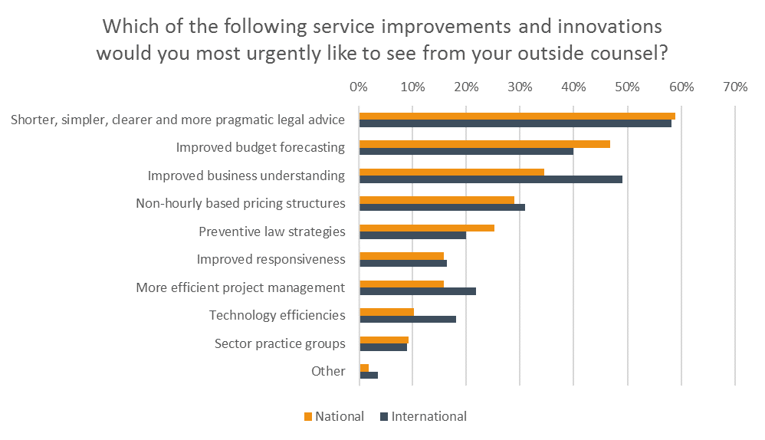

Slide 14
Become a curious and active follower
2.

Slide 15
Make technology a pillar of your culture
3.

Slide 16
Consider alternative pricing
4.

Slide 18
OPENING REMARKS
EUROPEAN JUDICIAL TRAINING: A NEW TRAINING STRATEGY
PETER CSONKA

Slide 19
FIRST PLENARY: Future soft skills

Slide 20
FIRST PLENARY – Speakers
BENEDICTE BURY, CCBE expert, Conseil national des barreaux
ANTOINE HENRY DE FRAHAN, Expert and co-founder of FrahanBlondé
FABRICE MAULEON, Expert in Business Transformation, Professor

Slide 21
FIRST PLENARY – Future soft skills
Transforming management of the law firm:
From an agile manager to a designed lawyer
BENEDICTE BURY

Slide 22
FIRST PLENARY – Future soft skills
Transforming management of the law firm:
From an agile manager to a designed lawyer
ANTOINE HENRY DE FRAHAN

Slide 23
FIRST PLENARY – Future soft skills
Transforming management of the law firm:
From an agile manager to a designed lawyer
FABRICE MAULEON

Slide 24
COFFEE BREAK 30 MINUTES

Slide 25
SECOND PLENARY: Innovative learning methods

Slide 26
SECOND PLENARY – Speakers
JULIAN LONBAY, Birmingham Law School
ENKE KEBEDE, Director of the Ecole Régionale des Avocats du Grand Est
RORY O’BOYLE, Solicitor, Diploma Co-ordinator at the Law Society of Ireland
JARKKO MÄNNISTÖ, Attorney, LL.D.

Slide 27
SECOND PLENARY – Innovative Learning Methods
Neuroscience and the new discoveries on effective learning
Interactive learning and the evolution of e-learning
JULIAN LONBAY

Slide 28
SECOND PLENARY – Innovative Learning Methods
Neuroscience and the new discoveries on effective learning
Interactive learning and the evolution of e-learning
ENKE KEBEDE

Slide 29
SECOND PLENARY – Innovative Learning Methods
Neuroscience and the new discoveries on effective learning
Interactive learning and the evolution of e-learning
RORY O’BOYLE

Slide 30
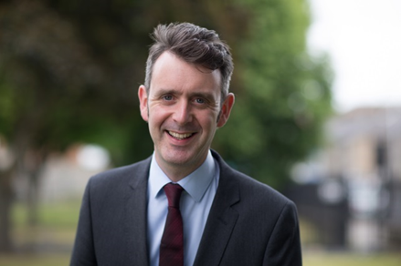
CCBE December 2017 Conference
Rory O’Boyle, Solicitor, Diploma Manager

Slide 31
Overview
Technology and why we use it
Webcasting
Online courses
Massive Open Online Courses (MOOCs)
iPad programme for trainee solicitors & the Apple Distinguished Program for 2015–2017
First – who we are!

Slide 32
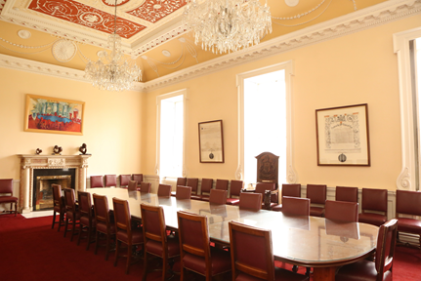
The Law Society of Ireland
Regulation
Representation
Education

Slide 33
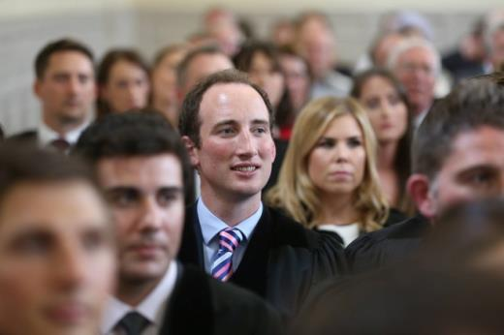
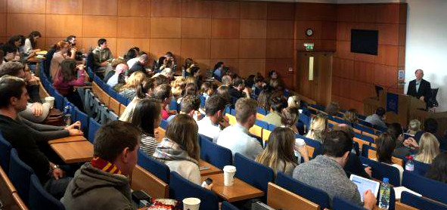
Education Department of LSI
The Professional Practice Courses
Professional Training
The Diploma Centre

Slide 34
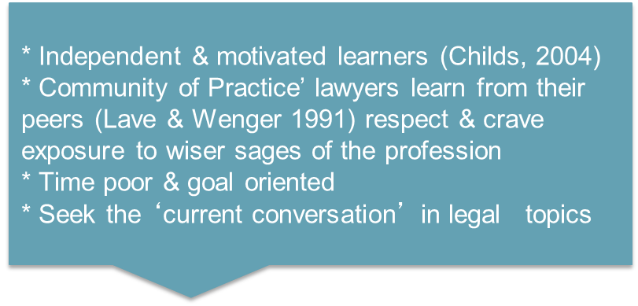
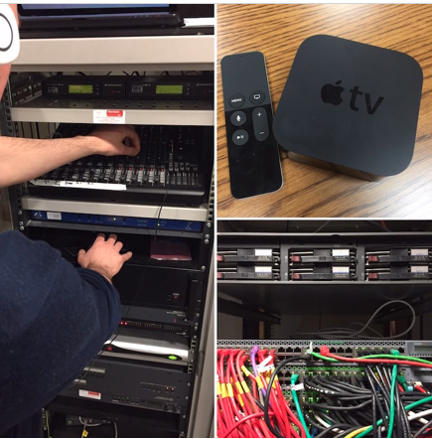
Technology and why we use it
Accessibility: We can serve the profession nationwide and those based internationally
Educational value: Technology leads to more effective ways of learning, maximizes opportunities to connect, and provides effective revisionary tools for exams
Flexibility: Time poor practitioners have a variety of means to access our courses and consume content
Relevance: It mirrors what is happening in practice and real life, technology and up skilling (Charles & Killian 2011)

Slide 35
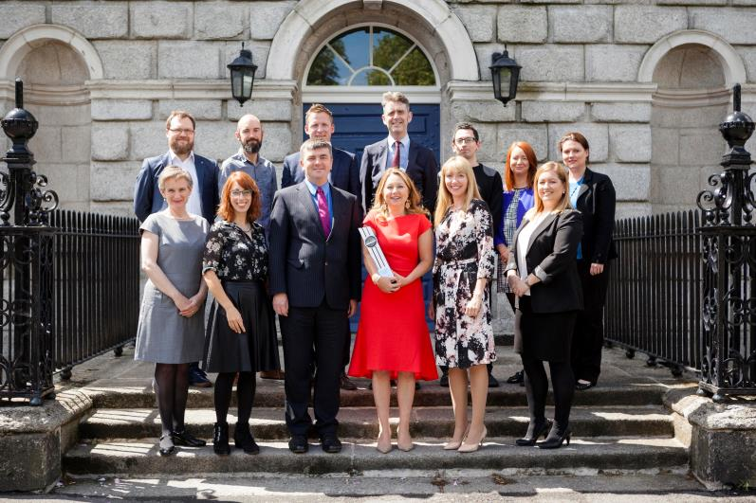
Diploma Centre
Postgraduate certificate, diploma and Master’s degree courses
Flexible on-site and online learning
Diverse range of specialist legal courses that reflect value, relevance and practicality
Public legal educaiton initiatives; MOOCs, Street Law & prison programmes

Slide 36
Webcasting onscreen delivery
In addition to:
Customised learning materials appropriate for online learning
Attention to design and multimedia learning principles
Encouraging engagement – peer to peer learning

Slide 37
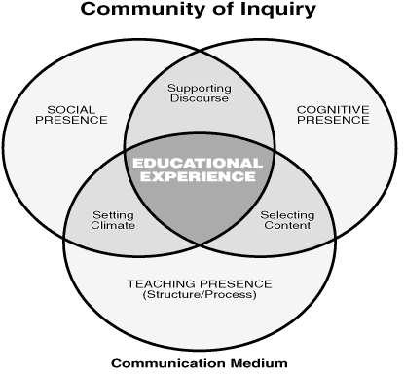
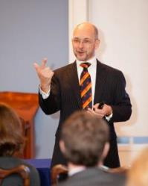
Garrison’s ‘Community of Inquiry’ model

Slide 38
Data Protection course
WATCH OUR VIDEO
Interactive activities to increase engagement
Incentivisation to use discussion forum
Online interactive workshops
Online assessments
Podcasts
Ask lecturers questions online

Slide 39
Business results of online courses
Increase student numbers
Reduction of staff working hours
Reduction of costs
Materials can be re-used for other courses
Course can be rolled out again with ease

Slide 40
Mobile app and paperless courses
Piloted paperless courses, using the iPad as a delivery method & study tool. Over 800 participants in our iPad courses
Build our own mobile platform. A customised app allows students to download lectures and notes (online or offline)

Slide 41
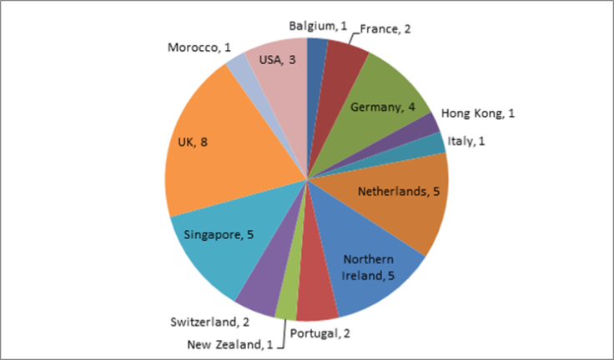
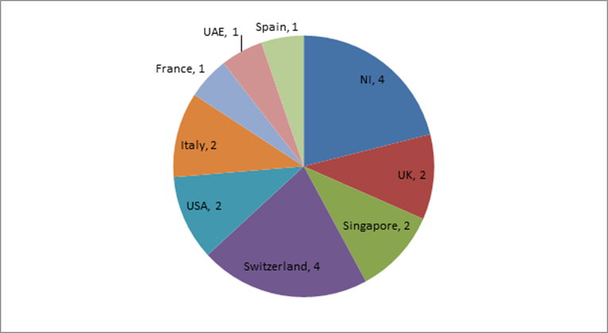
Who attends the Diploma Centre courses?
1005 students in 2016
Over 50% from outside Dublin
On track for 1050 students in 2017
International students
2016
2017

Slide 42
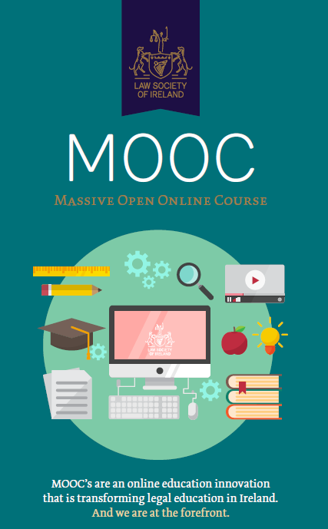
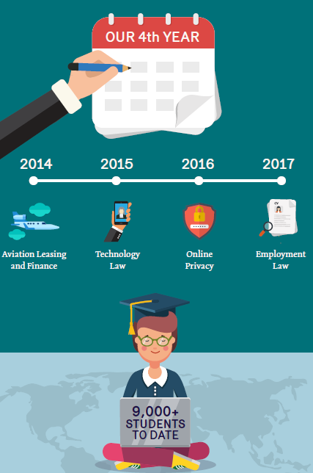
Massive Open online Course (MOOC)

Slide 43
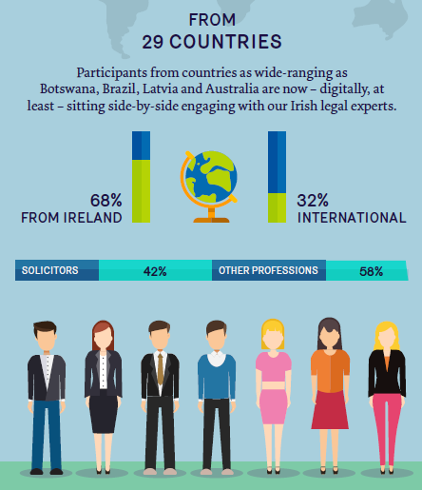
Massive Open online Course (MOOC)

Slide 44
Massive Open online Course (MOOC)
WATCH OUR VIDEO
Aligns with Law Society public interest objective to widen access to legal education and the legal profession for all
An opportunity to showcase solicitor talent and highlight how our members contribute to the economy and to the growth of other industries.
Designed to give individuals and businesses a greater understanding of the law
A learning and development opportunity for us: observation of platforms which deliver scalable professional education
A strategic marketing tool as they provide a platform to showcase our diploma approach and to convert a number of MOOC students to fee paying courses.

Slide 45
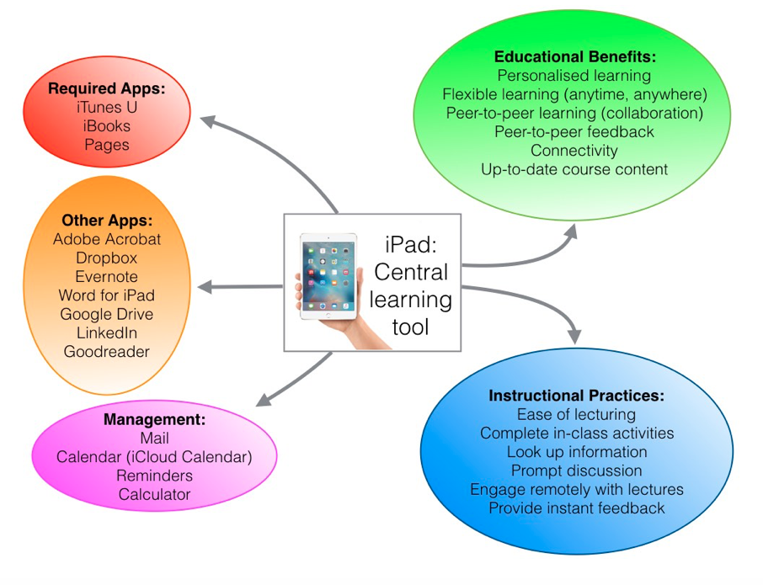
iPad programme for trainee solicitors

Slide 46
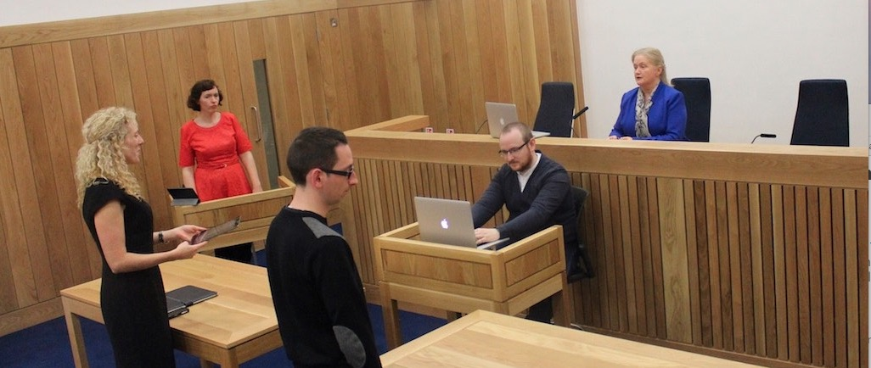
Reflecting the new work environment

Slide 47
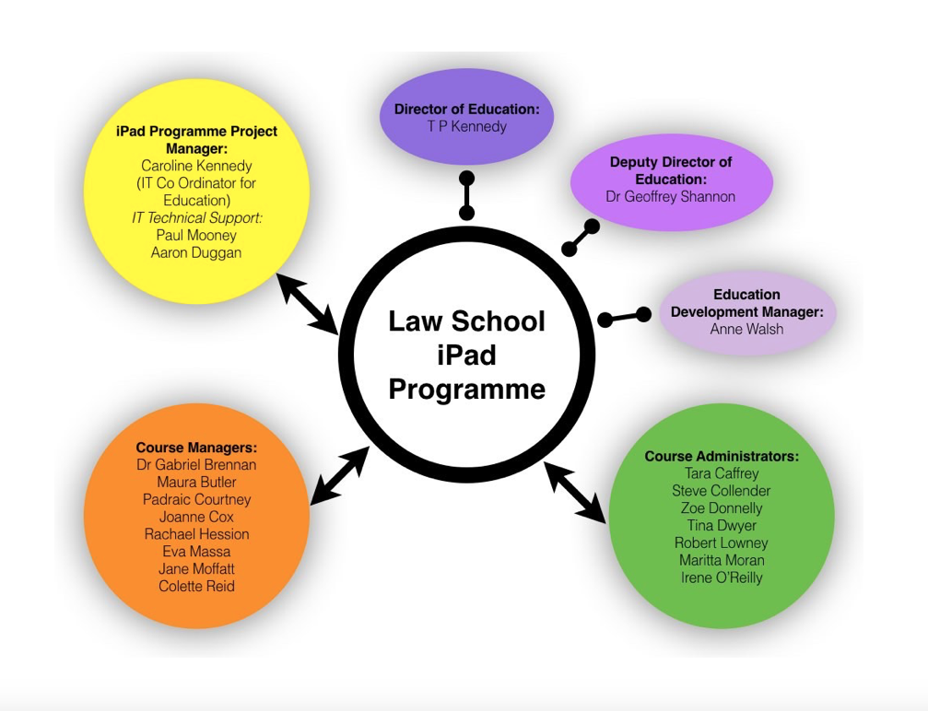
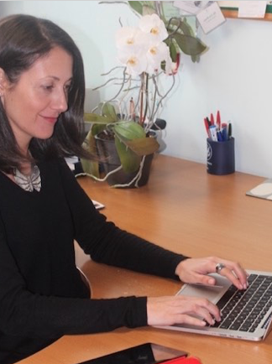
Implementation

Slide 48
Trainee solicitor experience

Slide 49
Testimonials

Slide 50
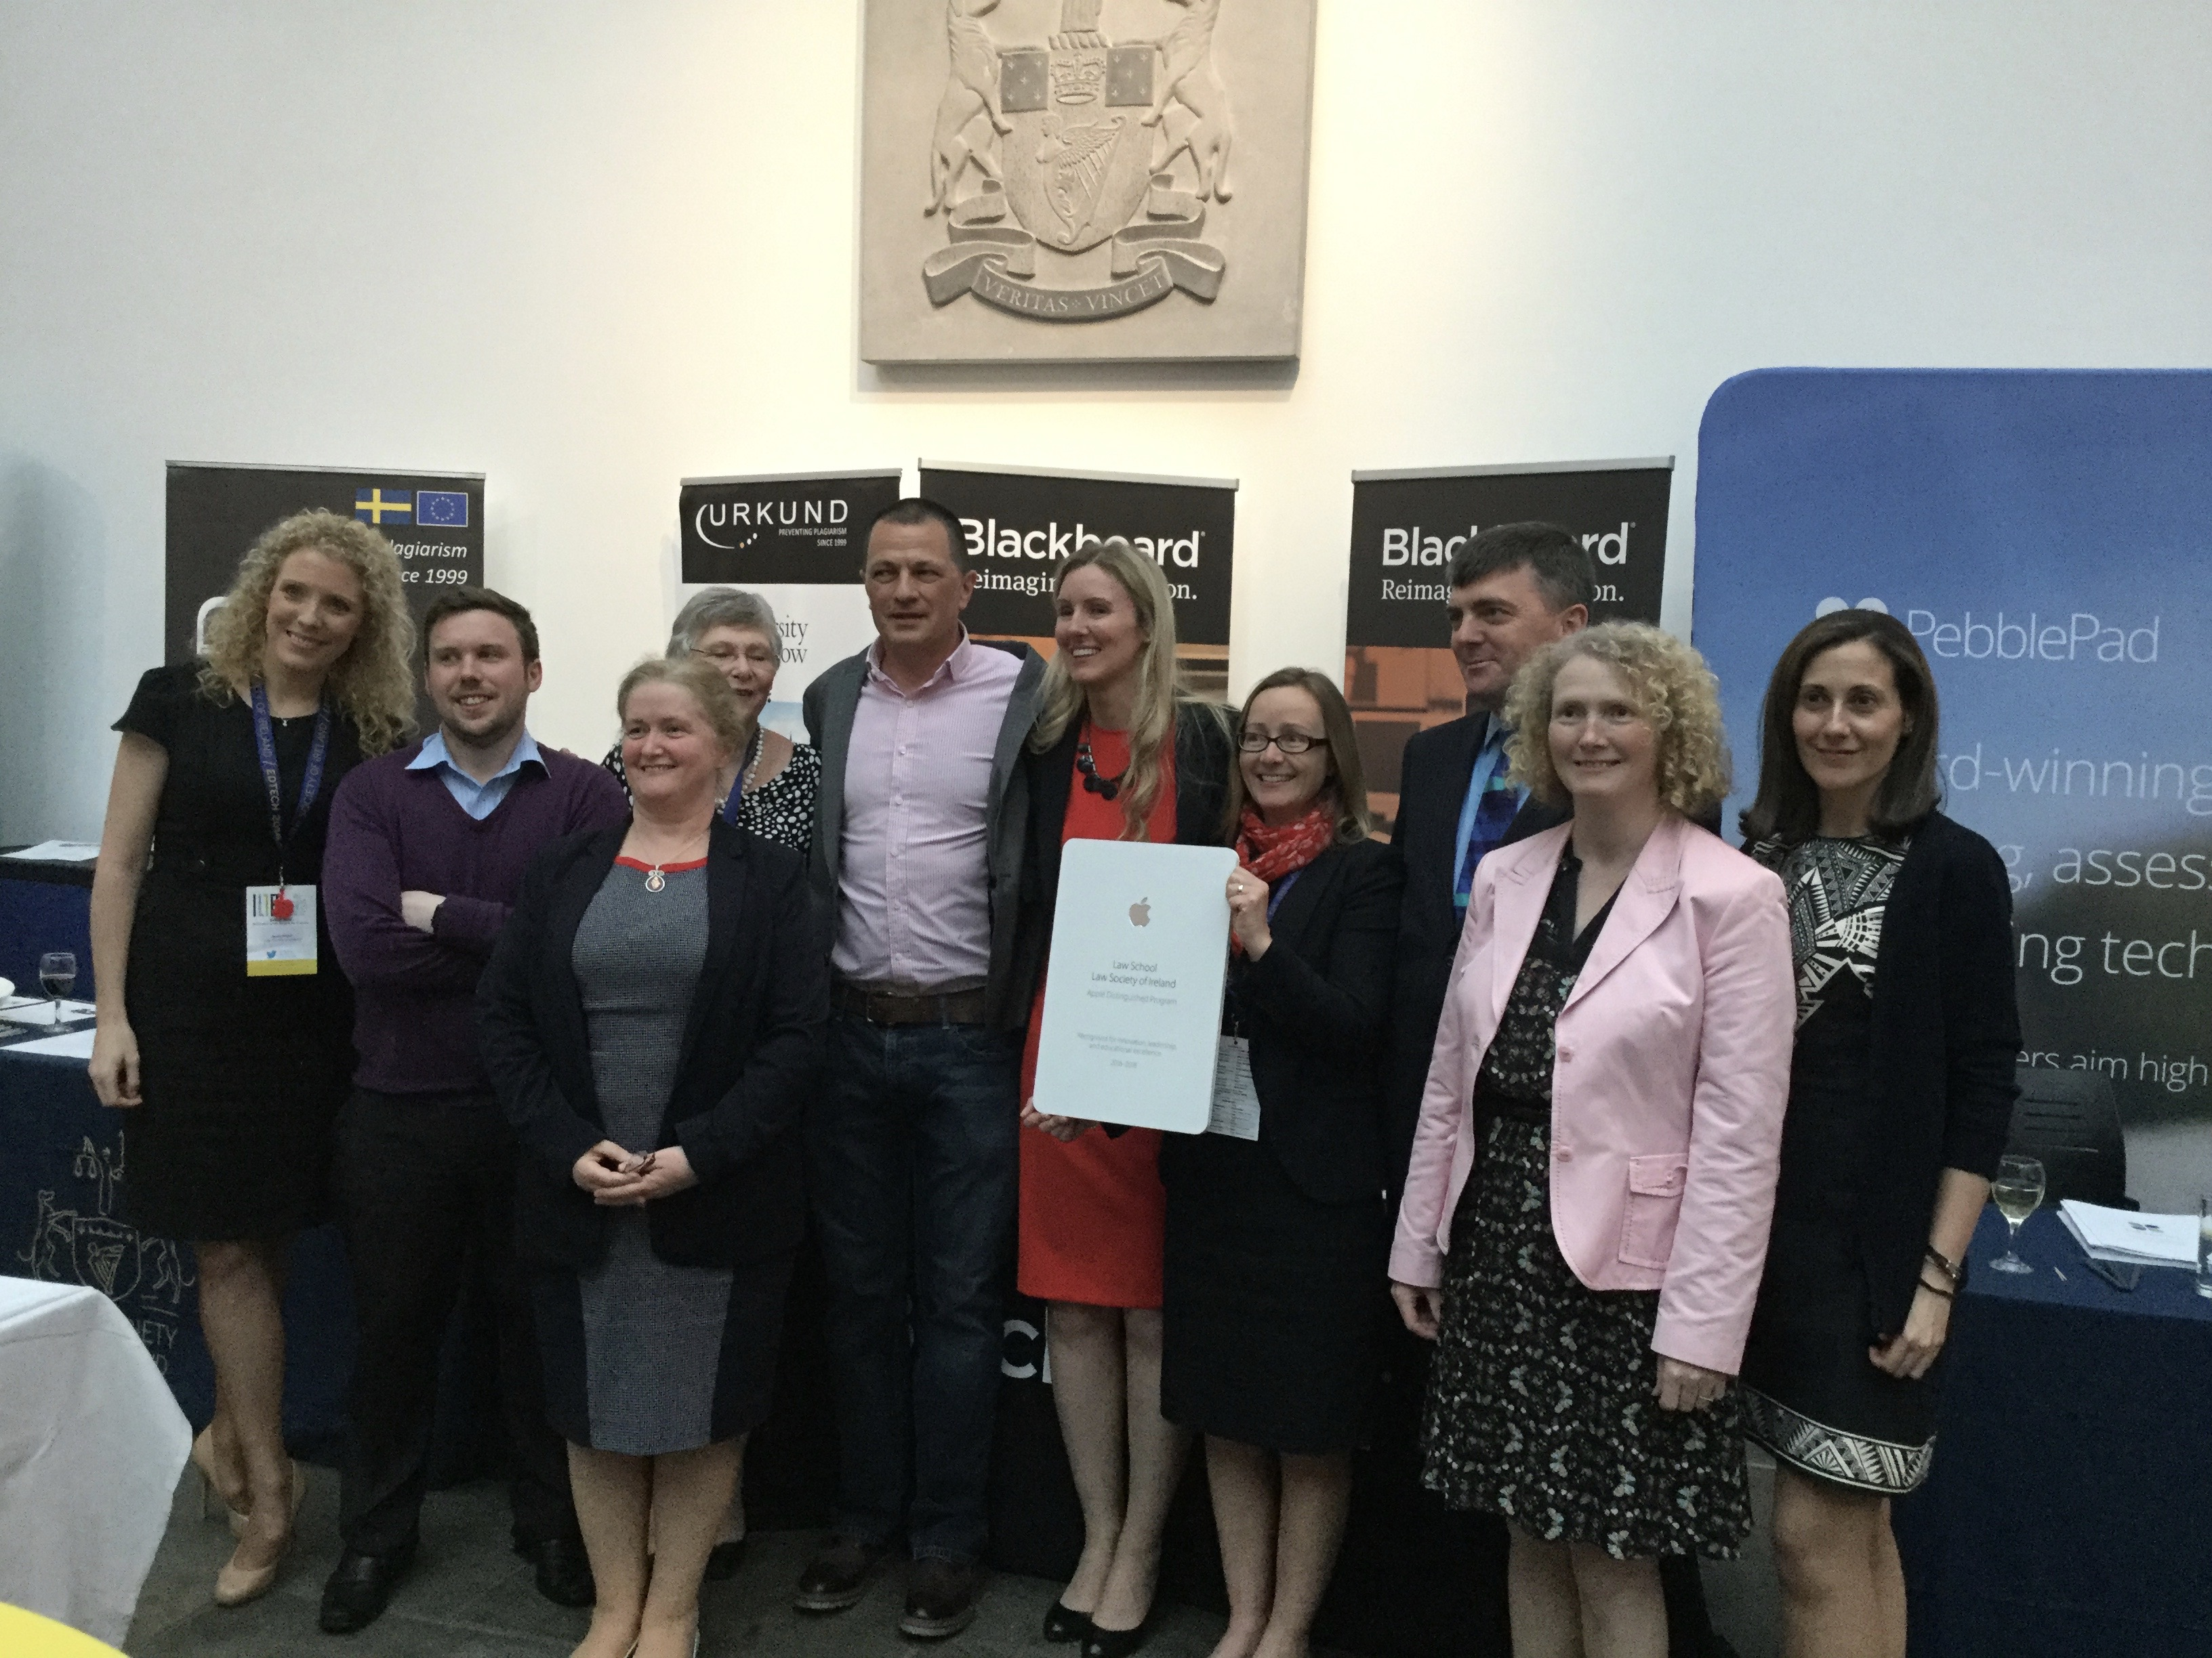
Apple Distinguished Program for 2015–2017

Slide 51
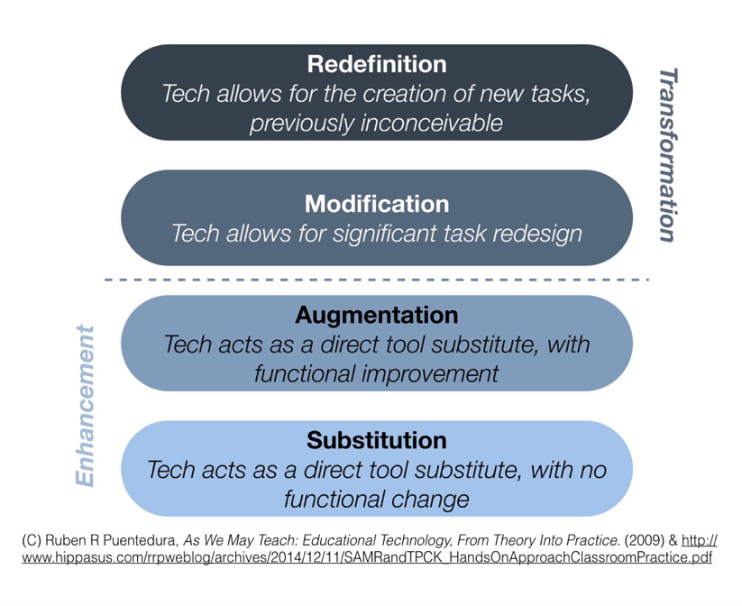
What did technology ever do for us?

Slide 52
Thank You

Slide 53
SECOND PLENARY – Innovative Learning Methods
Neuroscience and the new discoveries on effective learning
Interactive learning and the evolution of e-learning
JARKO MÄNNISTÖ

Slide 55
Legal skills training in the 21st century

Slide 56
Go online, go live

Slide 57
Show, don’t tell

Slide 58
Doing is learning

Slide 59
Be a coach, (not a critic)

Slide 60
The s”tudent
learns what the student wants to learn

Slide 61
LUNCH BREAK WORKSHOPS BEGIN AT 13:30

Slide 62
FINAL PLENARY: Introduction to the European Training Platform

Slide 63
FINAL PLENARY – Speakers
ATTRACTA O’REGAN, Head of Law Society Professional Training, Law Society of Ireland
DJAMILA BEN-MILOUD, European Commission, DG Justice and Consumers

Slide 64
FINAL PLENARY
Introduction to the European Training Platform
ATTRACTA O’REGAN

Slide 65
FINAL PLENARY
Introduction to the European Training Platform
DJAMILA BEN-MILOUD

Slide 66
CONCLUSIONS
PIER GIOVANNI TRAVERSA

