Slide 1
CCBE CONFERENCE: TRAINING OF LAWYERS, CHALLENGES AND OPPORTUNITIES WORKSHOP 1b EU FUNDS FOR TRAINING OF LAWYERS WIFI L42 Pass: allfornet

Slide 2
WORKSHOP 1b
Jonathan Goldsmith, European Lawyers Foundation (ELF)
Emmanuelle Cretin-Magand, DG Justice and Consumers
Andrzej Urbanik, DG Justice and Consumers
Jean-Philippe Rageade, ERA, Deputy Director /Director of Programmes

Slide 3
EU funds for training of Lawyers
JONATHAN GOLDSMITH

Slide 4
European Lawyers Foundation’s Training Projects
CCBE Conference
“Training of Lawyers: Challenges and Opportunities”
Jonathan Goldsmith
Brussels, 14 December 2017

Slide 5
TRALIM
Project consortium | Coordinator: European Lawyers Foundation Partners: Spain, Greece (Athens), Italy, Ireland & Poland (Legal Advisors)
Project duration | 1 year (15/06/2016 – 14/06/2017)
Project funds | 80% financed by DG Justice (Justice Programme) 20% financed by partners
Number of seminars | 4 (Spain, Greece, Ireland and Italy)
Objective | 150 lawyers trained (+20 lawyers than initial target)
Satisfaction rate | 4.22/5 (based on participants rating)
Sustainability | Due to the project’s success, the same partners together with the Paris Bar have submitted a new project proposal (TRALIM 2) to train 600 lawyers. The project would include seminars on EU immigration and asylum law, unaccompanied minors and short visits to reception centres.

Slide 6
TRAVAW
Project consortium | Coordinator: European Lawyers Foundation Partners: Spain, Greece (Athens), Italy, Ireland, Poland (Legal Advisors), England & Wales (Bar Council) and Northern Ireland (Bar Council)
Project duration | 18 months (01/12/2016 – 31/05/2018)
Project funds | 80% financed by DG Justice (REC Programme) 20% financed by partners
Number of seminars | 7 (Spain, Greece, Ireland, Italy, Poland, England and Northern Ireland)
Objective | To train 210 lawyers (30 from each country) 170 trained so far in 5 seminars (+20 from target) Drafting a Manual on Violence Against Women (Foreword by Commissioner Jourová)
Satisfaction rate | 4.35/5 (based on ratings from 5 seminars)
Dissemination | TRAVAW features on the EU’s VAW dedicated website ELF participates at the EU’s Non.No.Nein Campaign ELF participated at the EC’s Annual Colloquium on Fundamental Rights 2017 (focus on Women’s Rights) and has been invited to other similar events

Slide 7
MULTILAW
Project consortium | Coordinator: European Lawyers Foundation Partners: Spain, Greece (Athens), France (Paris), Poland, Romania, Lithuania, Czech Republic
Project duration | 24 months (01/07/2017 – 30/06/2019)
Project funds | 80% financed by DG Justice (Justice Programme) 20% financed by partners
Objective | Exchange of 75 lawyers (young lawyers with up to 5 years of professional experience) among the partner institutions for a period of 2 weeks
Host institutions | National or local bars and private law firms in Spain, Greece, France, Poland, Romania, Lithuania, Czech Republic and the Netherlands (ELF)
State of play | First round of exchanges (18 participants) is ongoing from December 2017 until the end of February 2018.
Sustainability | MULTILAW aims to establish a permanent exchange scheme for lawyers, mirroring the good practice of EJTN for judges and prosecutors

Slide 8
TRADATA
Project consortium | Coordinator: European Lawyers Foundation Partners: Spain, France (Paris), Ireland, Northern Ireland, England, Italy, Germany, Montpellier (Training School) and Belgium
Project duration | 24 months (15/11/2017 – 14/11/2019)
Project funds | 80% financed by DG Justice (REC Programme) 20% financed by partners
Objective | To train lawyers on the EU Data Protection Reform entering into force in May 2018
Number of seminars | 21 training seminars in 21 different cities and 8 different jurisdictions will take place over the course of the project
Lawyers to be trained | 630 lawyers from 8 jurisdictions will receive training on the new EU data protection reform
Training material | Training material from the various seminars will be available on the ELF’s website for every legal professional to consult

Slide 9
EU funds for training of Lawyers
EMMANUELLE CRETIN-MAGAND

Slide 10
EU Financial support to European judicial training
CCBE Workshop
EU funds for training of lawyers
14 December 2017
DG Justice and Consumers
Emmanuelle CRETIN-MAGAND
General criminal law and Judicial training Unit

Slide 11
A national responsibility
Training of justice professionals: a national competence
Training of judges and prosecutors: national judicial training entity (school, academy, supreme court, ministry department, etc.)
Training of court staff: ministries and courts
Training of self-organised professions like lawyers: the bar associations and law societies and / or their training departments and/or the private sector

Slide 12
A European support competence
TEU, art. 17
European Commission: guardian of the treaties
TFEU, art. 81.2.h and 82.1.c
"Training of the judiciary and judicial staff" to support judicial cooperation in civil and criminal matters
Objectives
Correct and coherent implementation of EU law
Mutual trust between justice professionals in cross-border judicial proceedings

Slide 13
A European support competence
Horizontal support and advice:
Relationships with the legal professions
European e-Justice Portal, in all EU languages:
Training material for self-learning of legal practitioners and for trainers, including e-learning
Repository of best training practices for trainers
In future: European training platform
In all EU languages: https://e-justice.europa.eu

Slide 14
A European support competence
Financial support for the training of lawyers:
The Justice programme, including a specific "European judicial training" call for proposals for action grants
2018 Annual Work Programme: publication 01/2018 Training call for proposals: publication Q1 2018 Budget: € 5 350 000. Co-funding rate: 80%
The Rights, Equality and Citizenship Programme
Future calls: http://ec.europa.eu/research/participants/portal/d esktop/en/opportunities/just

Slide 15
The Justice programme
2018 policy priorities
Transnational / cross-border activities
Topics:
Civil law (civil, commercial, family matters) Criminal law (judicial cooperation, procedural rights, anti-money laundering)
Fundamental rights
=> See the text of the Call for proposals for details
The training needs should be evidenced

Slide 16
The Justice programme
In 2018: supported activities
Seminars with easy linguistic access (providing interpretation in the languages of the participants, national breakout groups or linguistic
programme components prior to the training or during the training)
Cross-border training activities for multipliers
(trainers, participants who will act as multipliers)
Cross-professional training

Slide 17
The Justice programme
In 2018: types of training activities
Interactive, practice-oriented seminars
Multilateral exchanges between practitioners
Cross-border initial training activities
Joint study visits to EU courts
Creation of training content
Tools for training providers

Slide 18
The Justice programme
Quality of training
"Advice for training providers" (in all EU languages)
https://e-justice.europa.eu/content_training_material-252-en.do
"Handbook on Judicial Training Methodology in Europe" compiled by the European Judicial Training Network (EJTN) (in all EU languages)
http://www.ejtn.eu/Documents/Methodologies_Resources/Training
%20Methods/EJTN_TT_Handbook_Final.pdf

Slide 19
Any questions?
Thank you for your attention
Contact:
JUST-JUDICIAL-TRAINING@ec.europa.eu

Slide 20
EU funds for training of Lawyers
ANDRZEJ URBANIK

Slide 21
Action grants by DG Justice & Consumers
The NEW application procedure
CCBE Workshop
EU Funds for training and lawyers
14 December 2017
Andrzej Urbanik
DG Justice and Consumers
Unit 0.4 Programme and financial management

Slide 22
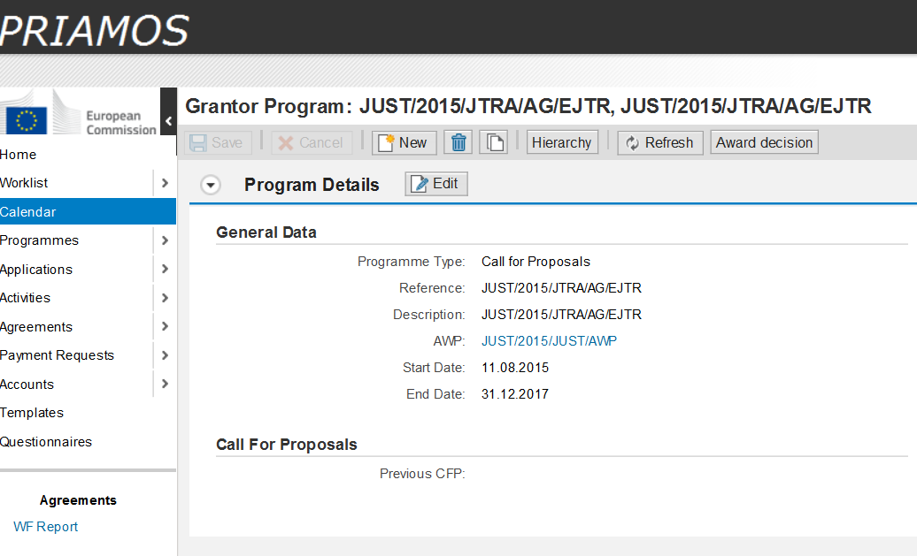
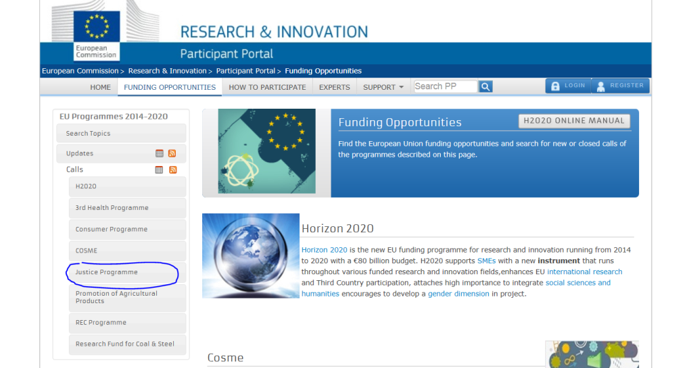
Transition– from PRIAMOS to Participant Portal (PP):
http://ec.europa.eu/research/participants/portal/desktop/en/opportunities/index.html
Notes:
Go to funding opportunities.
- look if there's any call published
- check what is the submission opening date
- check what is the submission closure date.

Slide 23
Main consequences:
different interface,
changes in terminology (i.e. call becomes topic),
differences in the application procedure,
different annexes,

Slide 24
How to work with Participant Portal?
Check regularly funding opportunities on the Participant Portal, select the Justice (or REC) programme,
check what is the submission opening date,
check what is the submission closure date.

Slide 25
Once the topic is published on the portal:
Read carefully the topic conditions!
Is your organisation eligible to apply?
Does your project idea address the priorities?
Do you have the minimum partnership? Is your proposed partnership appropriate for implementing your project?
What are the award criteria and their weighting? DG Justice will harmonise the award criteria for all topics (25,30, 15,20,10)

Slide 26
Preparation
Start preparing ''at least'' once the topic is published (it may be a few weeks/months before it is opened for submission),
Read the new Guide for applicants, which explains the new procedure (available under each topic notice on the PP)
Consult your partners
Address any IT related question through the helpdesk contact form: http://ec.europa.eu/research/participants/api/contact/index.html
For non-IT related questions write directly to DG Justice&Consumers: ec-justice-calls@ec.europa.eu for Justice programme and ec-rec-calls@ec.europa.eu for REC programme

Slide 27
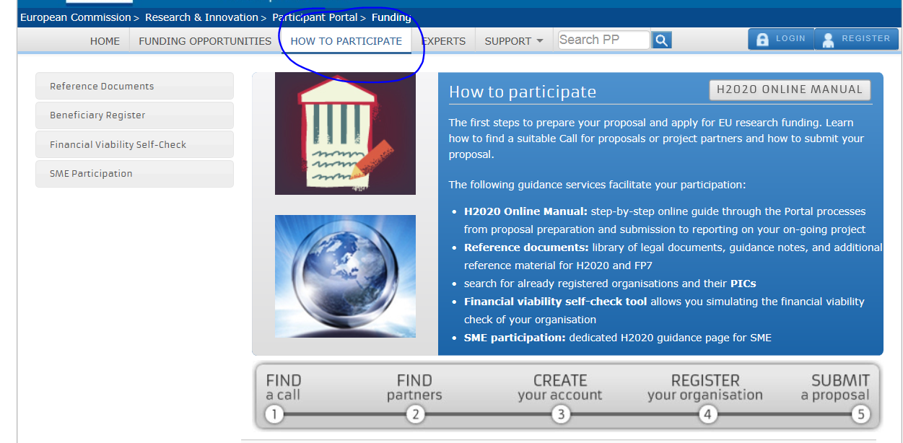
2 steps application process:
Step 1. Create a user account and register your organization on the participants portal:
Part A: dynamic form which administrative information

Slide 28
2 steps application process:
Step 2. Apply for a project:
3 parts:
Part A, which includes the administrative information about coordinator and partners and the estimated budget table,
Part B, which comprises of the technical content of the proposal; and
Annexes (e.g. Annual activity report, Indicators)

Slide 29
Specific issues regarding project application:
Simplified budget table – no details,
All MS Word and MS Excel files must be converted to *.pdf before uploading to the system,
All partners must register and then they are selected by the project coordinator in Part A (no separate partner declarations).
No associate partners, thus no declarations.
Detailed explanation in the new Guide

Slide 30
After submission
Regularly check your email: Commission my contact you to ask for clarifications/additional documents or information
Be patient: the evaluation takes between 4 and 6 months
All unsuccessful applicants receive letter with reasons
Successful applicants: grant agreement preparation

Slide 31
Thank you for your attention!
Questions?
Please address your questions to the functional mailbox:
ec-justice-calls@ec.europa.eu
ec-rec-calls@ec.europa.eu

Slide 32
EU funds for training of Lawyers
JEAN-PHILIPPE RAGEADE

Slide 33
EU funds for training of lawyers: the experience of ERA
Training of lawyers: challenges and opportunities
CCBE conference
Brussels, 14 december 2018

Slide 34
Before starting…
ERA is a non-profit public foundation set up in 1992 at the initiative of the European Parliament whose patrons include all EU member states (minus Estonia). ERA provides training in EU law to “legal practitioners”
Traditional target groups: judges, prosecutors, and lawyers in private practice
Categories of events by funding type:
Open events, co-financed projects, service contracts
Participation of lawyers
More and more EU funded projects aimed at lawyers (either partly or exclusively)

Slide 35
Bars and schools of law teaming up with ERA in recent EU-funded projects
(1) National/Local Bars and lawyers’ schools from:
Czech Republic (Czech Bar Association), Finland (Finnish Bar Association), France (DBF in Brussels, ERAGE, Haute École des Avocats Conseil), Greece (Athens Bar Association), Hungary (Budapest Bar Association), Ireland (Bar Council of Ireland, Law Society of Ireland, The Honorable Society of King’s Inns), Latvia (the Latvian Bar Association), Lithuania (Lithuanian Bar Association), Poland (National Council of Legal Advisers of Poland, Polish Bar Foundation), Spain (General Council of Spanish Lawyers, Illustre Collegi d'Advocats de Barcelona ICAB, Bar Association of Vizcaya-Bilbao)
(2) European level: ELF, ECBA

Slide 36
Cross-border training on EU criminal law for defence counsel
EU funded projects organised in cooperation with the European Criminal Bar Association (ECBA) and various national Bar Associations from 2011 to 2015
15 seminars for ca. 420 defence lawyers from all the EU. Each seminar focused on defence lawyers from a different cluster of countries.
Methodology: the seminars consisted of lectures in plenary on Fridays afternoon with simultaneous interpretation provided – English/French/German + language of the hosting country. National workshops on Saturdays where no interpretation was needed.
Regional seminars with national breakout sessions: concept was identified as best practice (COM/EJTN) because (a) it enables direct correlation between EU instruments and practical application in national context, (b) it ensures active participation in native language, (c) it is cost-efficient.

Slide 37
EU litigation for lawyers
EU-funded project organised in cooperation with the European Lawyers’ Foundation (ELF) and 10 Bar Associations/Lawyers’ Schools in 2016-2017
5 seminars in Trier for 130 lawyers (litigators) from the partner countries, mainly in English (1 seminar in French)
All seminars combined with a visit to the CJEU
Methodology: lectures and case studies on the practical aspects of litigating cases before the Court of Justice – with a focus on direct actions before the CJEU.

Slide 38
Free resources and training materials on the ERA website developed in the framework of EU projects (also of relevance for lawyers)

Slide 39
Thank you for your attention!
Jean-Philippe Rageade
Director of Programmes and Deputy Director
jrageade@era.int

