Slide 1
CCBE CONFERENCE: TRAINING OF LAWYERS, CHALLENGES AND OPPORTUNITIES WORKSHOP 2 CHOOSING THE TOOLS FOR TRAINING WIFI L42 Pass: allfornet

Slide 2
WORKSHOP 2
Julian Lonbay, Birmingham Law School
Hugo Domingos, Blended Training
Jim Moser, Expert in strategic learning and development
John Coughlan, ERA, Deputy Director / Director of Corporate Communications
Jon Harman, Assistant Professor at Volda University College
Matthew J. Homewood, Head of Department and Associate Professor, HEA National Teaching Fellow, Nottingham Law School
Paresh Kathrani, Dr. at Westminster Law School
Ralf Hilgenstock, eLeDia - eLearning im Dialog GmbH
Vanessa Carbajal, Senior Partnership Development Manager at FutureLearn

Slide 3
Choosing the appropriate, innovative tool for training
JULIAN LONBAY

Slide 4
Choosing the appropriate, innovative tool for training
HUGO DOMINGOS

Slide 5
5
e-Learning
Trends
E-LEARNING
CCBE Training Conference
Brussels - 14.12.2017
Hugo Domingos / Blended Training Services

Slide 6
DESENHO PEDAGÓGICO
FOCADO NAS NECESSIDADES
DA ORGANIZAÇÃO
There’s no “One size, fits all”.
Each organization is a different challenge!
6
People
Learning Styles
Workplace
Budget
Business Needs
Technological Infrastructure
Time / Space Flexibility
Skills
e-Learning Trends - CCBE Training Conference
Notes:
A diversidade de necessidades formativas exige uma solução que seja versátil » elearning tem essa capacidade!

Slide 7
Questions about the effectiveness of e-Learning
7
e-Learning Trends - CCBE Training Conference
Notes:
As incertezas com o investimento do elearning!
Vamos provar que é possível responder “sim “ a estas dúvidas!

Slide 8
Creating e-Learning courses
8
Interoperability:
PC only
Smartphone / tablet specific
Total Compatibility
Delivery method:
eLearning
Blended Learning
Micro-learning
Pedagogical strategy:
Expository
Role-play
Simulation
Exploration
Multimedia Integration:
Rich multimedia SCORM
Video / Audio only
Simulations / Games
eBooks
e-Learning Trends - CCBE Training Conference
Notes:
Exercício 3:
Que elementos são importantes de serem considerados na criação de conteúdos em elearning?

Slide 9
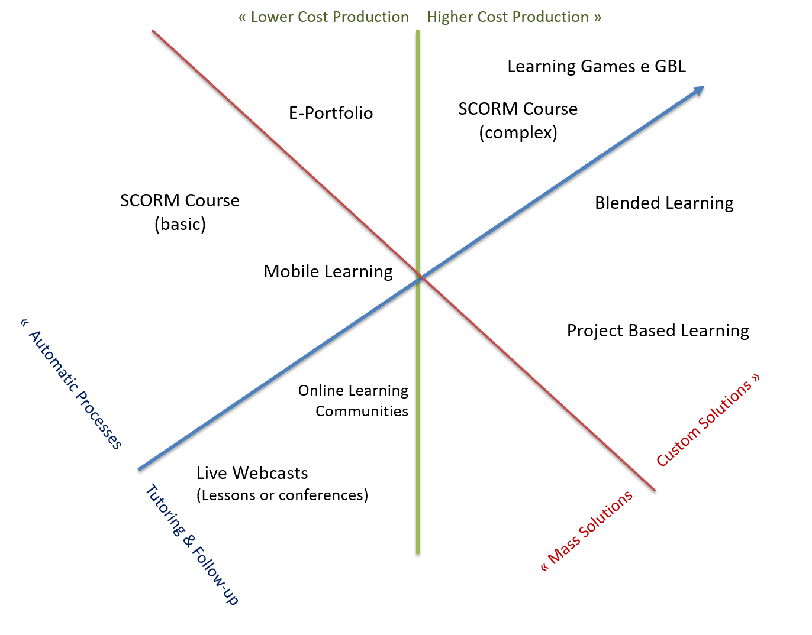
9
Moving away from a ‘one size fits all’ mindset for eLearning, the more organizations use and get comfortable’ with eLearning, the more they are able to broaden their use of the medium, incorporating next generation formats to full effect.
e-Learning Trends - CCBE Training Conference
Notes:
Exercício 3:
Que soluções/formatos existem e qual o mais adequado?
Formandos: Iniciar o exercício 3 em brainstorm com formadores!

Slide 10
10
Gamification is about more than just playing games (in fact, sometimes it does not involve playing games at all).
It can be defined as the concept of applying game-design thinking to non game applications.
Gamification is the use of game thinking and game mechanics in non-game contexts to engage users in solving problems.
e-Learning Trends - CCBE Training Conference

Slide 11
Video Based Learning
11
If a picture is worth a thousand words, then video may be worth a million or more.
Benefits of video-based learning:
1. Adds life to the e-learning course by making it effective and engaging. 2. Increases learner engagement and participation. 3. Reduces cognitive overload and maximizes retention. 4. Provides a simpler and practical learning experience. 5. Is a cost-effective training approach.
e-Learning Trends - CCBE Training Conference

Slide 12
12
Interactive Video
By asking the learner to engage via knowledge checks, drag and drop tests, quizzes, or scenario-based video learning (showing consequences of a certain action) it is no longer just passive learning.
e-Learning Trends - CCBE Training Conference

Slide 13
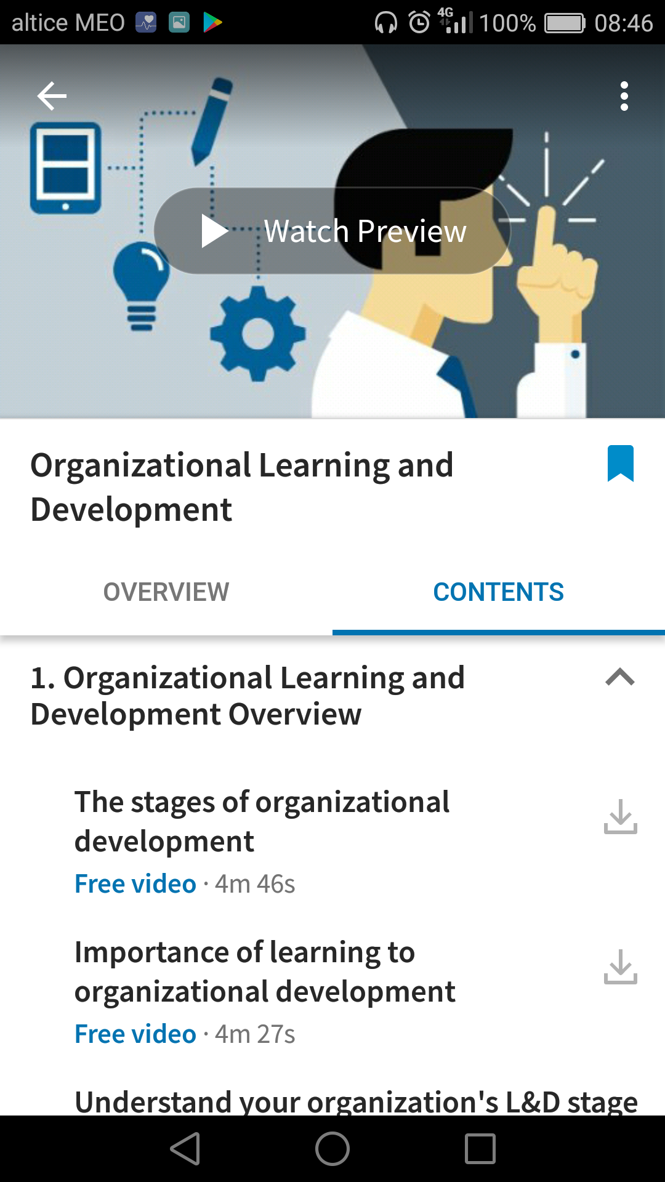
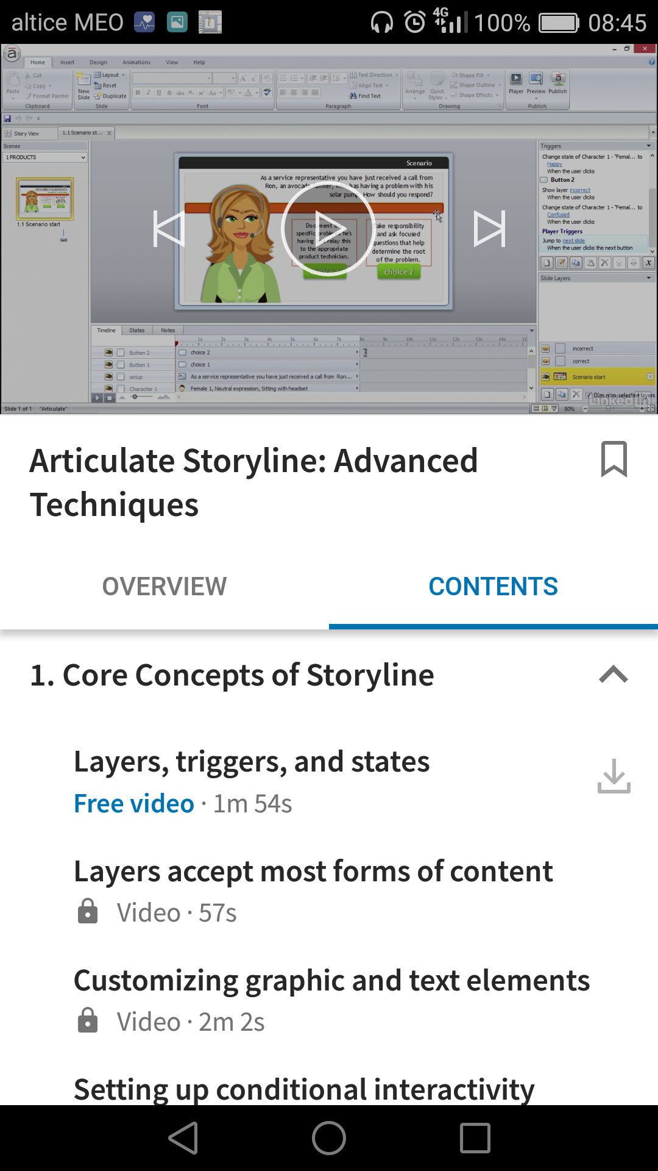
13
Video Lessons/Courses
The courses are broken into bite-sized segments that can be viewed anytime, on any device, online and off.
Learning content is recommended throughout your LinkedIn.com experience, helping you easily discover relevant courses, and the content can be integrated with a learning management system.
e-Learning Trends - CCBE Training Conference

Slide 14
DESENHO PEDAGÓGICO
FOCADO NAS NECESSIDADES
DA ORGANIZAÇÃO
14
Benefits of Gamification in eLearning?
Better learning experience. The learner can experience “fun” during the game and still learn if the level of engagement is high.
Better learning environment. Provides an effective, informal learning environment, and helps learners practice real life situations and challenges in a safe environment. This leads to a more
Prompting behavioral change. Points, badges, and leaderboards can make training more fun. However, gamification is more about engaging learning experience that facilitates better knowledge retention.
Can be applied for most learning needs. Gamification can be used to fulfill most learning needs including induction and onboarding, product sales, customer support, soft skills, awareness creation, and compliance.
e-Learning Trends - CCBE Training Conference

Slide 15
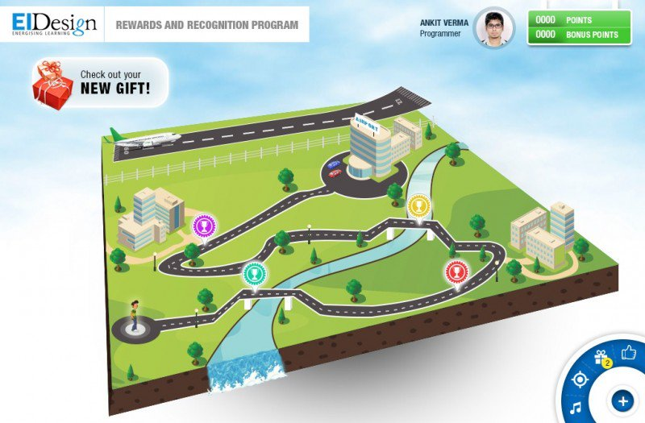
DESENHO PEDAGÓGICO
FOCADO NAS NECESSIDADES
DA ORGANIZAÇÃO
15
Game based learning course
The learners go through a series of gamified activities that map to the required qualities of a given reward category. The activities simulate and reinforce the qualities the individuals have to maintain to win.
The scores lead them to gaining the reward. This approach also features leaderboards.
e-Learning Trends - CCBE Training Conference

Slide 16
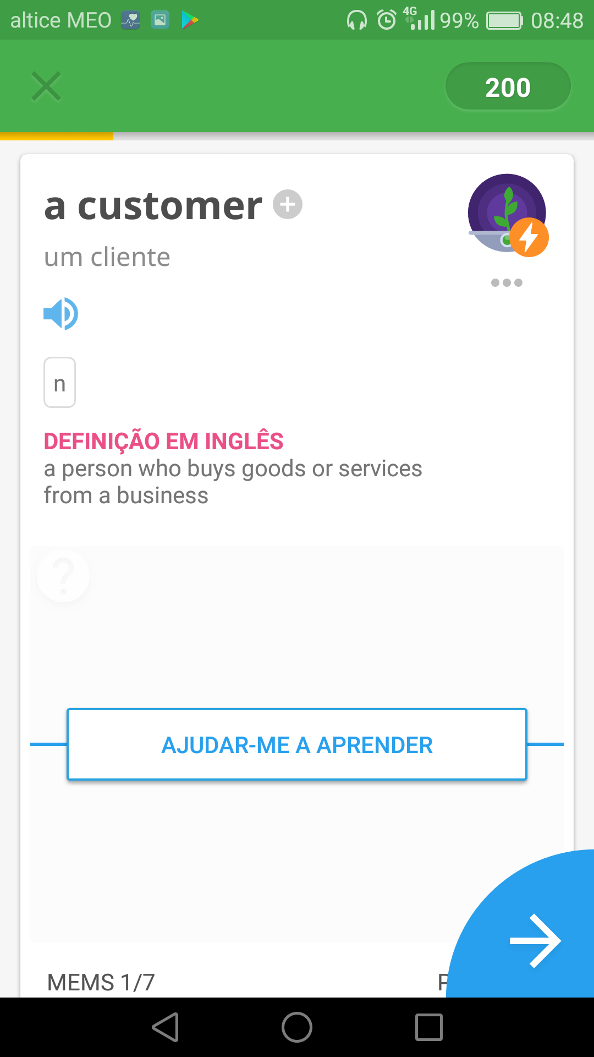
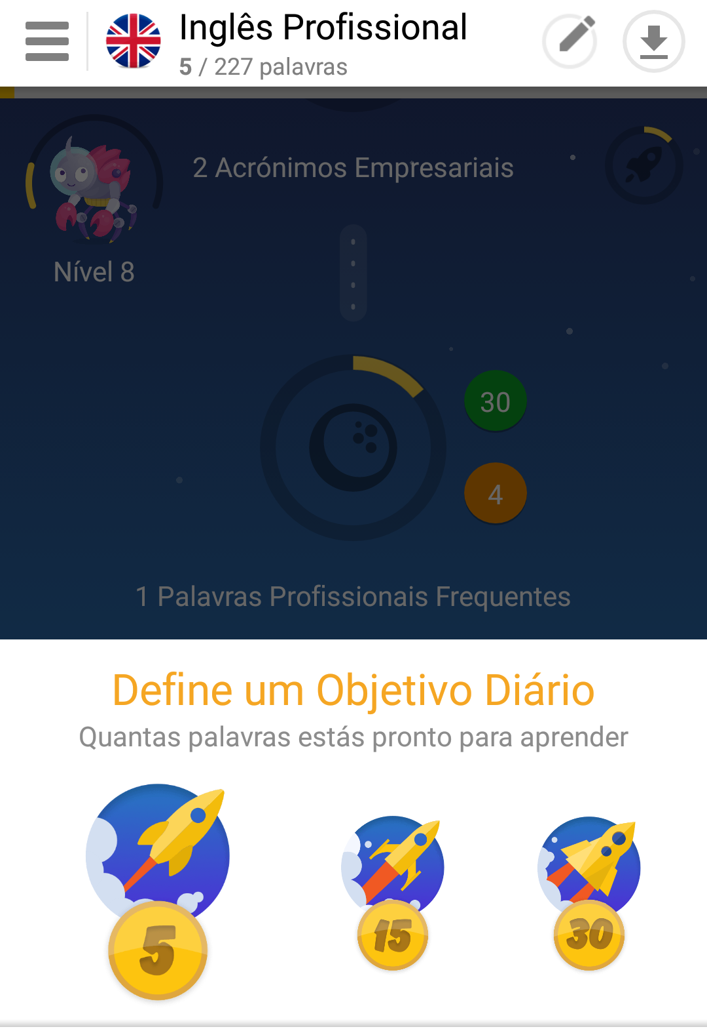
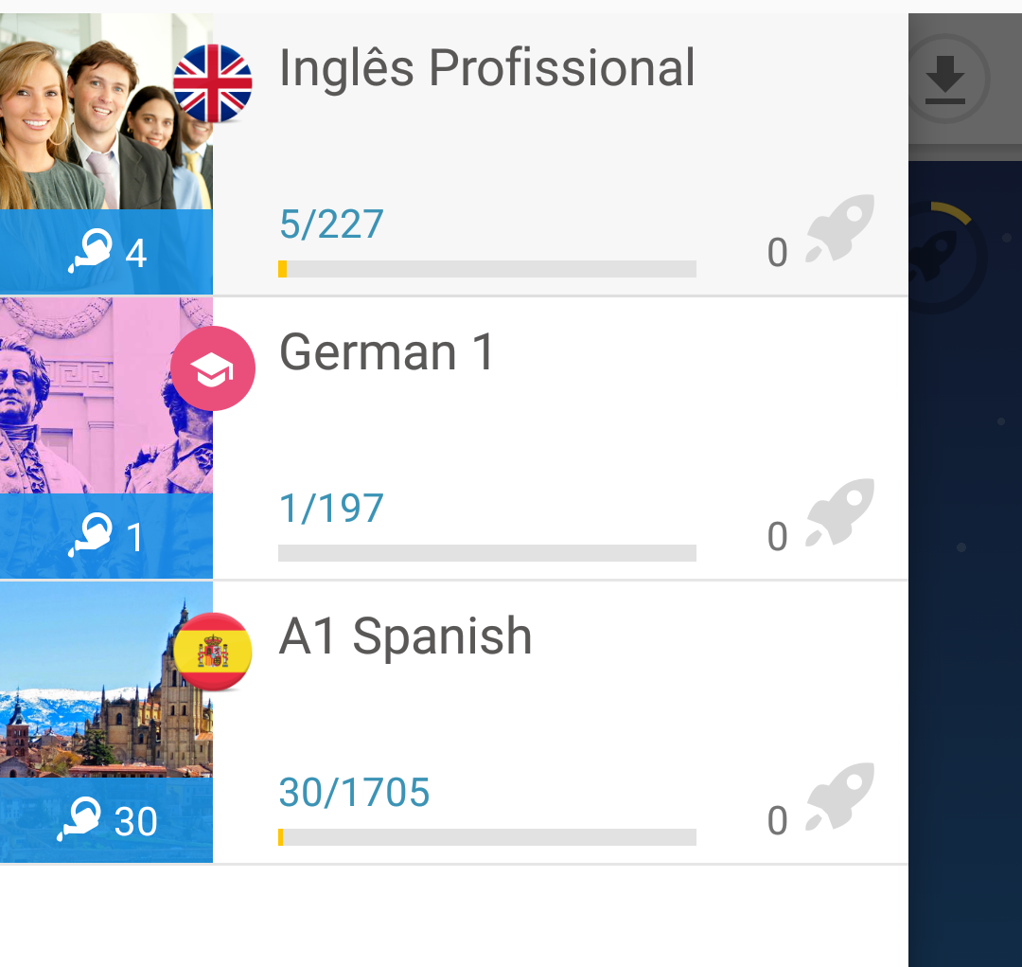
DESENHO PEDAGÓGICO
FOCADO NAS NECESSIDADES
DA ORGANIZAÇÃO
16
Learn anywhere, anytime
Learn a new language with games, humorous chatbots and over 30000 native speaker videos.
A learning experience that fits in your pocket and translates to useful, real-life language skills.
e-Learning Trends - CCBE Training Conference

Slide 17
Social Learning
17
“Social media is technology used to engage three or more people. Social learning is participating with others to make sense of new ideas. What’s new is how powerfully they work together.” - Jeanne Meister
Social learning is learning that takes place through social interaction between peers and it may lead to a change in attitudes and/or behavior.
» Social Learning Strategies:
Tutoring Interaction
Q & A Sessions
Group Discussion Interaction
Online Learning Communities
MOOC
e-Learning Trends - CCBE Training Conference

Slide 18
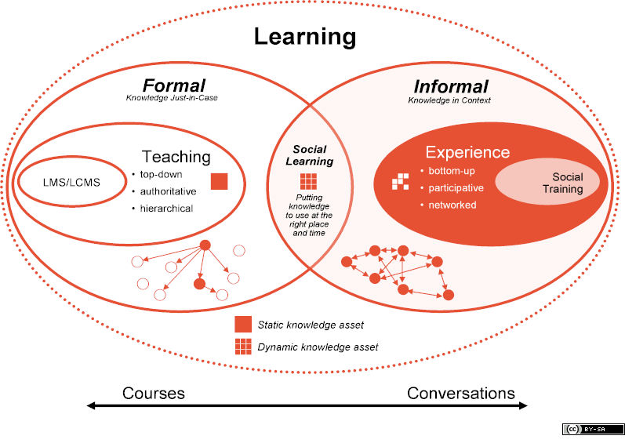
18
Integrating
Social Learning
“By bringing together people who share interests, no matter their location or time zone, social interaction has the potential to transform the workplace into an environment where learning is as natural as it is powerful.” ― Marcia Conner, The New Social Learning: A Guide to Transforming Organizations Through Social Media
e-Learning Trends - CCBE Training Conference
Notes:
Reforçada a importância da tutoria, transitar para a relevância da aprendizagem social como uma nova etapa na criação e acompanhamento a cursos.
Esclarecer o que é a aprendizagem social e o seu contexto com a aprendizagem formal.

Slide 19
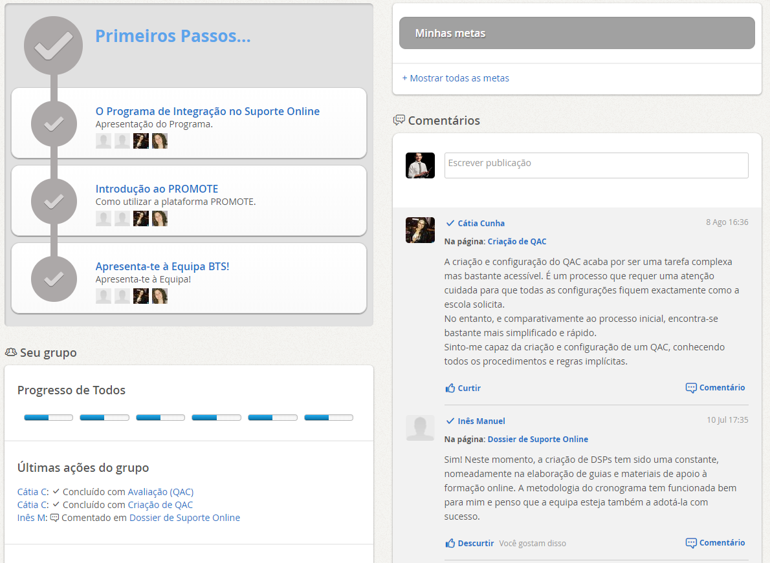
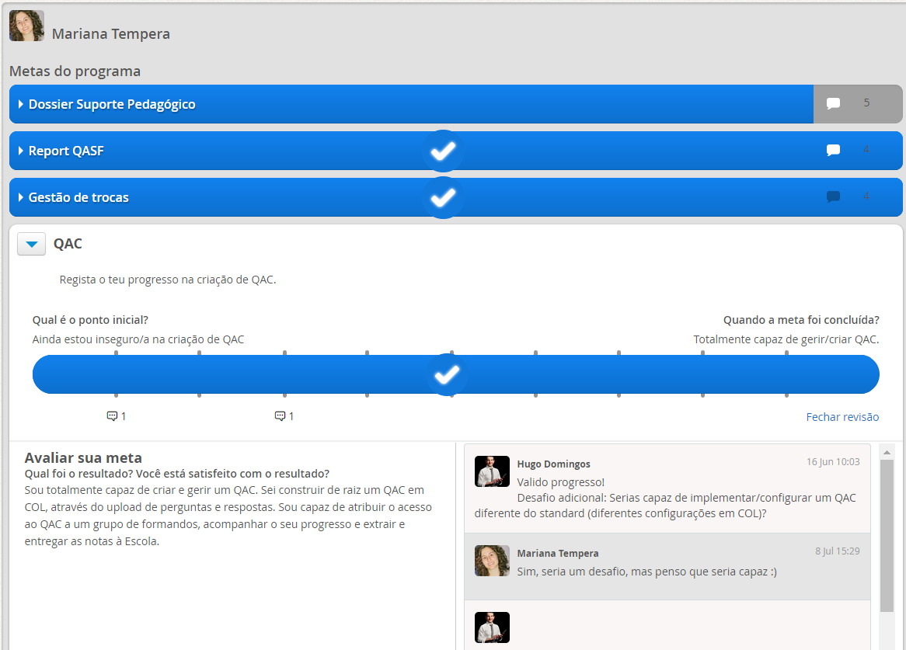
Promote facilitates focused on-the-job experience sharing throughout the learning journey.
19
https://promoteint.com
Guided Social Learning
When participants set out to try new behaviors, they want to feel that they are not alone, and to learn from the real-life experiences of others. Participants get inspired by the actions of others, share best-practice, reflect, collaborate and network with each other.
e-Learning Trends - CCBE Training Conference

Slide 20
Let’s Share Ideas!
What are your training goals?
Hugo Domingos
Blended Training Services
hugo.domingos@blendedtraining.pt
https://www.linkedin.com/in/hugodom
https://twitter.com/hugodom

Slide 21
Choosing the appropriate, innovative tool for training
JIM MOSER

Slide 22
Choosing the appropriate, innovative tool for training
JOHN COUGHLAN

Slide 23
Choosing the appropriate, innovative tools for training
Workshop 2, CCBE Training Conference, Brussels, 14 December 2017
John Coughlan, Deputy Director/Director of Communications, ERA — Academy of European Law

Slide 24
EUROPEAN LAW
Directives
Regulations
Case Law
N A T I O N A L L A W

Slide 25
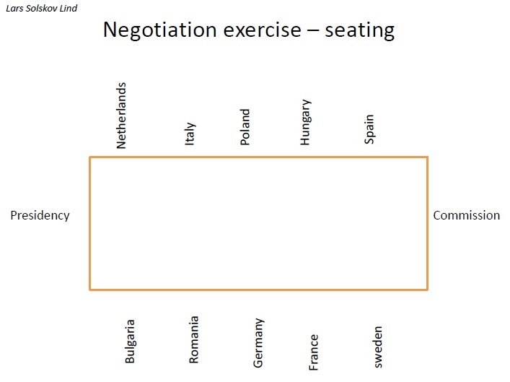
Face-to-face training
Design your own
Applicability
Clusters
Simulation
Image Credit: https://media.licdn.com/mpr/mpr/AAEAAQAAAAAAAAXrAAAAJGVlZTBlZWZmLWM4NGYtNGFkMC1hOTcxLTc5NmYzNDY4ZmY2Yw.jpg

Slide 26
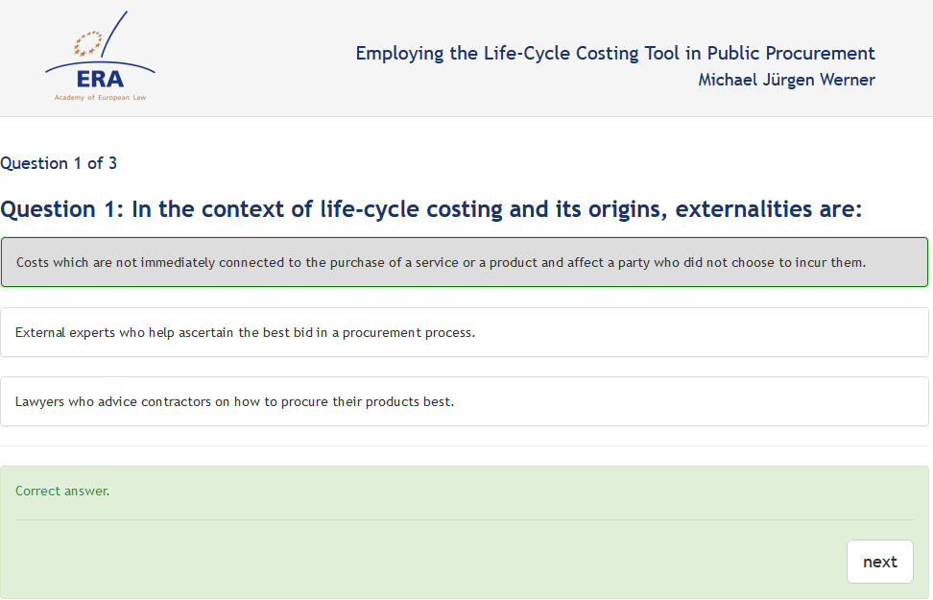
Online training
Interaction
Certification
Free content

Slide 27
Training materials
National & European
Language of the law
Impact and sustainability

Slide 28
Thank you for your attention!
european.law
www.era.int
youtube.com/c/europeanlawERA

Slide 29
Choosing the appropriate, innovative tool for training
MATTHEW J. HOMEWOOD

Slide 30
Choosing the appropriate, innovative tool for training
PARESH KATHRANI

Slide 31
Council of Bars and Law Societies of Europe: Training of Lawyers, Challenges and Opportunities
Gamification and
Legal Education
Dr. Paresh Kathrani
Westminster Law School
University of Westminster, London, UK
Email: p.kathrani@westminster.ac.uk Twitter: @Pkathrani

Slide 32
Introduction
Dr Paresh Kathrani
Senior Lecturer in Law, Westminster Law
School, University of Westminster, London, UK
Module Leader of Criminal Law
Research: Technology in the Legal Profession
and in Legal Education

Slide 33
Serious Games at Westminster (SG@W)
https://www.westminster.ac.uk/serious-games-at-westminster-research-group
Colleagues including:
Vassiliki Bouki (Computer Science)
Daphne Economou (Computer Science)
Markos Mentzelopoulos (Computer Science)
Frands Pedersen (Politics and International Relations)

Slide 34
Use of Computer
Games in Legal
Education

Slide 35
Sound advice to a client

Slide 36
Facts
Application
Sound advice to a client
Law

Slide 37
Formal Learning Outcomes of Criminal Law, including:
A broad understanding of the knowledge base…
The ability to apply the legal knowledge of Criminal Law to solve legal problems
A research strategy that encompasses the identification and selection of a range of authoritative and reliable materials
Effective communication of outcomes…
Etc

Slide 38
Traditional methods:
Law Hypothetical
Problem Question

Slide 39
…Coincidence of the AR and MR…
Max sets out to commit a robbery and attacks Simon with his bare fists, knocking him out. Max then leaves to use Simon’s bank card and when he returns, sees that Simon is still unconscious. He thinks Simon has died from the blows and he throws Simon into the river to hide the body. In fact, Simon is not dead, but subsequently dies from drowning. Discuss the liability of Max...

Slide 40
Read, arrange and absorb the facts
Legal Reasoning
Judgement and Advice
Law on AR and MR

Slide 41
Skateboards!

Slide 42
Written Problem Question
-Law
-Read, arrange and absorb the facts
-Legal reasoning
-Judgement and advice

Slide 43
-Law
-Read, arrange and absorb the facts
-Legal reasoning
-Judgement and advice
Limits

Slide 44
-Law
-Read, arrange and absorb the facts
-Legal reasoning
-Judgement and advice
Technology

Slide 45
Games
-Law
-Read, arrange and absorb the facts
-Legal reasoning
-Judgement and advice
Technology

Slide 47
By Vassiliki Bouki, Daphne Economou and Paresh Kathrani

Slide 48
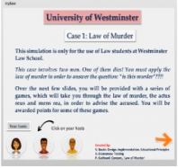
By Vassiliki Bouki, Daphne Economou and Paresh Kathrani

Slide 49
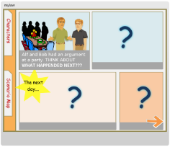
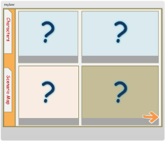
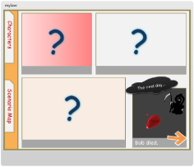
Law of murder
Experimentation with gamified solutio
The "story" is about two friends: Alf and Bob. After an argument Alf makes an action that results in Bob"s death.
Preparation
Students are given the first and the last in a series of events and they are asked to fill the gaps.
They are asked to write down their own answers and then compare them with the correct answer.
After that they are given the full events (in a format of a comic story).
Articulate Storyline

Slide 50
Drag and Drop & Cognition
Gamified Elements
Cognitive Processes
Question points

Slide 51
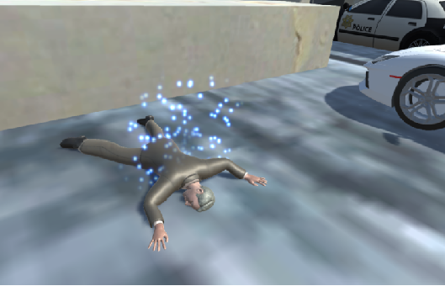
By Paresh Kathrani, Markos Mentzelopoulos, James Parrish

Slide 52
- Expansive and affective
Gamified elements:
time, points, levels
Strategy
Growth
- Goal orientated
Games

Slide 53
- Expansive and affective
Gamified elements:
time, points, levels
Strategy
Growth
- Goal orientated
Problem Question
-Law
-Read, arrange and absorb the facts
-Legal reasoning
-Judgement and advice
Games

Slide 54
Law
Read, arrange and absorb the facts
Legal reasoning
Judgement and advice
Expansive and affective Gamified elements: time, points, levels Strategy Growth Goal orientated

Slide 55
Three law games

Slide 56
Press

Slide 57
Professional Bodies

Slide 58
More games
planned, especially
augmented reality

Slide 59
Thank you

Slide 60
Choosing the appropriate, innovative tool for training
RALF HILGENSTOCK

Slide 61
Choosing a LMS System A Checklist
Ralf Hilgenstock, CEO eLeDia

Slide 62
Hosting
Learning Mangement Systems
Consulting Training
Customization Integration
Authoring
Tools
Learning scenarios

Slide 64
Some Tips:
Don’t start with selecting a tool, think about scenarios.
The terminology in LMS market is confusing.
Think 3 years ahead.
Don’t follow the hypes. Most are shortsighted.

Slide 65
Didactical scenarios What do you want?
Compulsory courses based on web based trainings (SCORM)
Unsupported ↔ supported learning
Short learning units ↔ long term units
Online learning ↔ blended learning
Live online learning: webinars ↔ asynchronous communication
Mobile devices support -- offline learning
Social learning → learning communities
Planned learning ↔ on demand learning
(Daily) Learning nuggets
Are your ideas realistic? Does it fit with the corporate learning and communication culture?

Slide 66
Your content – what are your standards?
LMS systems have content creation tools – most are easy to use.
Authoring tools have advanced features – often more complex.
Budget: 1 hour learning time 5.000 € → 50.0000 €

Slide 67
Administrational aspects
How to manage user accounts? internal & external users
How to manage course enrolements?
And reports?
Integration in IT landscape AD/LDAP; data exchange with HR systems,….

Slide 68
Technical aspects
Internal data center or external hosting: can you switch?
Software as a service or own licence?
Commercial or open source?
Only configurable or customizable?
Maintenance contracts and user support

Slide 69
Contact
Ralf Hilgenstock eLeDia GmbH – eLearning im Dialog Mahlower Str. 23/24 D - 12049 Berlin
info@eledia.de https://eledia.de
phone: +49 30 5056 1070 fax: +49 30 5059 0860
https

Slide 70
Choosing the appropriate, innovative tool for training
VANESSA CARBAJAL

