Slide 1






CCBE Conference
“Modernisation of European Company Law”
Wednesday 27 November / 9.00 - 16.30
With the kind participation of:

Slide 2
Opening Speeches
José de Freitas
    President of the CCBE
Michel Forges
President of the French-speaking Bar of Brussels
Peter Callens
President of the Dutch-speaking Bar of Brussels
#CCBEconference2019
#EUCompanyLaw

Slide 3
Keynote Speech
Koen Geens
  Deputy Prime Minister and Minister of Justice, Belgium
“The new Belgian Company Code in light of European evolutions”
#CCBEconference2019
#EUCompanyLaw

Slide 4
Panel I
  Recent Legislative Achievements
  in European Company Law
Moderator: Hans Jürgen Hellwig
Partner, Hengeler Mueller, Frankfurt; Honorary Professor in European Company Law, University of Heidelberg
#CCBEconference2019
#EUCompanyLaw

Slide 5
Panel I
Vanessa Knapp OBE
    Independent Consultant; Member of the former EU Informal Expert Group on Company Law; Visiting Professor, Queen Mary University of London
Cross border divisions in practice
#CCBEconference2019
#EUCompanyLaw

Slide 6

What I will cover
Background to the new provisions
The sorts of divisions covered
The documents needed
The process
Protections for members, creditors and employee participation
Notes:
6

Slide 7

Background to the provisions on cross-border divisions
Provisions on PLC divisions since 1982 within a member state
- but not cross border divisions
Less than half of member states had provisions
Lack of harmonised framework makes it difficult + more expensive
Different protection of stakeholders
Notes:
Respondents to 2015 consultation confirmed that divisions offer way for companies to change organisational structure, adapt to changing market conditions + realise new opportunities
7

Slide 8

Which divisions will be covered
Only a division to:
- one or more newly-formed companies (partial) or
- two or more newly-formed companies (full) or
- division by separation
Transfer of all or part of company’s assets and liabilities
New companies issue shares/securities
- to dividing company or its members
- may use cash – limited to 10%?
At least 2 companies in different member states
Does the dividing company meet the requirements?
Excluded cases
Notes:
Full division – existing company must be dissolved
Division by separation – co transfers part of assets and liabilities in exchange for issue to company being divided of securities/shares in newly formed cos - can’t issue cash in this case
Dividing company
Is the company to be divided a limited liability company formed in a member state?
Does it have its registered office, central administration or principal place of business in the EU?
Excluded cases eg
Company is in liquidation + begun to distribute assets or is subj to resolution tolls, powers and mechanisms
MS option if co is subj to insolvency proceedings or preventative restructuring framework or other liquidation proceedings or crisis preventaion measures
8

Slide 9

What documents are needed?
Draft terms of cross-border diversion
- required contents
Constitution(s) in new member state
Management/administrative organ report:
- to members and employees
- one report with two sections or two reports
- required contents
Independent expert report for members
Notice of general meeting to approve the division
Application to obtain a pre-division certificate
Application for division in the new member state(s)
Notes:
Draft terms of cross-border division – not needed if all members agree to waive
Management or administrative organ should draw up
Contents – include
Info on dividing and receiving companies – legal form and name and location of RO = constitution of recipient cos
Ratio for exchange of shares/ securities
Proposed timetable
Safeguards offered to creditors
Offer of cash compensation to members
Repercussions on employment
Info on procedures to involve employees for participation in new co
If required by MS, declaration by management or admin organ that unaware of any reason why company should be unable to meet its liabilities when fall due after conversion
How assets + liabilities are to be divided – what kept by dividing co (if anything)
Report to members + employees
Explaining + justifying the legal + economic aspects of the cross border division + implics for ees
Members – not if all members agree to waive MS option to exclude single member cos from this Article
Explain + justify share exchange ratio
Cash comp + method used to determine it
Implications for members
Rights + remedies for members who oppose
Ees – not required if no ees other than those who are part of admin or management body
Implics for eee relatinships
Mat changes to condits of emement or location of bus
Effect on subs
Goes to members and eee reps (or ees if no reps)
If get an opinion from eee reps in good time inform members + append to report
Independent expert report to members
Examine draft terms of cross border division – whether cash comp + share exchange ratio are adequate
Required contents
All members can agree to dispense w report
MS can decide not to require this for single member company
9

Slide 10

Default rules for assets + liabilities
Unallocated assets + liabilities allocated to all recipient companies in proportion to the share of the net assets allocated to them under the draft terms
- for partial divisions, to all recipient companies and the company
being divided
Better for the terms to deal with this
Notes:
10

Slide 11

Process – before general meeting
6 weeks before general meeting
- dividing company makes available draft terms of cross border
division, report(s) to members and to employees
- independent expert appointed to examine terms and reports
- declaration of solvency made if required
1 month before general meeting
- draft terms + notice re submitting comments publicly available in
register
- Member State option to require disclosure of independent expert report
in register
Notes:
Disclosure
Notice to members, creditors + employees that they can submit comments on draft terms and report to company and competent authority
Company can disclose on its website instead – but there is still info that must appear in the register
11

Slide 12

Process – general meeting
Disclosure of draft terms + 3 months
- last date for creditors to apply for safeguards
General meeting – 5 working days
- last day for receiving comments on documents
Before general meeting – reasoned response given to employees
General meeting to decide on division
- at least 2/3rds but not more than 90% of the votes represented
- inform the competent authorities about the resolution, submit approved
terms
Notes:
Last date for creditors to apply for safeguards
3 months after public disc of draft terms
Will cos wait until after date has passed to hold their GM?
Meeting approval – must not be higher than for approving a cross-border merger
MS option that if something leads to member having an increase in its economic obligations to co or 3rd party, must be approved by member concerned if they can’t exercise their rights to cash comp
12

Slide 13

Process – after general meeting
General meeting + 1 month
- last date for members to declare wish to dispose of shares
Receipt of information about general meeting + 3 months
- competent authority decides whether to:
- issue pre-division certificate or
- give company chance to complete requirements in further period
or
- carry out in depth assessment (must be completed within further 3
months, extendable if applicant notified)
- pre-division certificate sent to other competent authorities

Slide 14

Process – effective date and after
Decision by competent authorities of recipient companies on legality
Cross-border division takes effect
- register notifies other registers
- all registers updated
Division takes effect + 2 months
- last time for company to pay cash compensation
to members
Notes:
Date takes effect – decided by law of MS of co being divided
14

Slide 15

Member protection
Right to dispose of shareholding for adequate cash compensation
if voted against the draft terms + would receive shares in a company in another
member state
- member state option to extend right to other members eg non-voting
- disposal to company, other members or, with company consent, third party
Company makes offer in draft terms
Last date to accept 1 month after general meeting
Can accept but demand recalculation before court or competent authority
- member state sets time limit for claim
Can also challenge share exchange ratio
- member state sets time limit
- if successful, pays cash or member state option to provide additional shares
Notes:
Apply in member state of co being divided
Ms option that decision is valid for all members who decided to dispose of shares
Exclusive competence is in juris of MS of co being divided
Claim for extra cash comp re share ratio does not prevent registration of division
15

Slide 16

Creditor protection
Member state must provide adequate system of protection of creditor interests
Member state option to require a solvency statement
Creditors may apply for adequate safeguards within 3 months of disclosure if dissatisfied with those offered in draft terms
- must show satisfaction of claims is at stake + they have not got
adequate safeguards
- if creditor does not obtain satisfaction from recipient company,
other companies are jointly and severally liable
- limited to value of net assets allocated at division date
Notes:
Creditors whose claims antedate disclosure of draft terms which have not fallen due at that time
Solvency decl - Declaration by management that, on basis of info available and after making rble enquiries, unaware of any reason why recipient co ( and for partial dividing co) unable to meet liabilities allocated to them when fall due
Disclosed with draft terms
16

Slide 17

Employee participation
Each recipient company subject to rules in force in own member state
- not if don’t provide same level of participation as dividing company or
- number of employees exceeds 4/5ths of threshold for employee
participation right
Dividing company must negotiate to determine participation level
- special negotiating body can decide to rely on rules in recipient company
states or negotiate a bespoke agreement
- if no agreement in 6 months, standard rules of employee participation apply
Recipient companies must maintain rights for 4 years
Inform employees of outcome of negotiations without undue delay
Notes:
Information and consultation rights must be respected, reasoned response given to ees before GM
Maintain rights – even if subsequent operations like mergers, divisions or conversion.
17

Slide 18

Review of the provisions
Commission must evaluate and report on the Directive within 4 years
Member States must provide data on the number of divisions, duration and related costs, refusal cases + negotiations on employee participation rights
Report on feasibility of rules for other cross-border divisions
Keep a note of problems, cases where you want more provisions
Notes:
18

Slide 19
Panel I
Prof. Pierre-Henri Conac
    Professor, University of Luxembourg
Cross border mergers
after the company law package
#CCBEconference2019
#EUCompanyLaw

Slide 20
Cross-Border Mergers after the Company Law Package
Pierre-Henri Conac
University of Luxembourg
Conference of the CCBE on the “Modernisation of European Company Law” (Brussels)
27 November 2019

Slide 21
Before the company law package, directive on cross-border mergers of limited liability directives (2005) was the only cross-border tool at the EU level with the exception of the Societas Europaea (SE), but which is very cumbersome
Cross-border conversions possible also but under Member State legislation
Request to the Commission by the Report of the Reflection Group on the Future of EU Company Law (2011) to provide several technical amendments (harmonisation of creditors’ rights, suspension of merger, valuation rules)
Cross-border merger regime was a great success but need for technical improvements confirmed by consultations : (2015), Consultation on a Package on (…) providing efficient rules for cross-border operations in EU Company Law … (2017) and requested by EU Parliament (Resolution of 13 June 2017 on cross-border mergers and divisions, P8_TA(2017)0248)

Slide 22
Proposal of Directive of 25th of April 2018 went beyond fixing procedural issues and included substantive provisions (exit right of shareholders)
Harmonised rules on protection of shareholders, creditors and employees
Harmonised rules on employee information (complaints before) as level of protection of employee participation was already significant
Harmonised rules for a fast track procedure for less complex mergers or waiver of an independent expert report upon agreement of all shareholders or during a merger of a parent company with a subsidiary
Interconnection of business registers for exchange of information

Slide 23
Changes during the legislative process
Rules on certification and « artificial arrangements » did not apply to mergers because it was an update of an existing regime and not new one
Provisions harmonised with those on cross-border conversions and divisions for consistency reasons and in order to avoid regulatory arbitrage
« artificial arrangements » replace by ex-ante anti-abuse control
Council: simplifications, precisions on valuation
European Parliament: employee representation

Slide 24
No extension of the scope to non limited liability companies : cross-border activities carried out mainly by limited liability companies, more complex, not enough time and issue can be dealt in two steps
Article 119(2)(d) clarifies that « side-step » cross-border mergers are covered by the directive : mergers without issuance of shares because the company is a wholly-owned subsidiary or the members of the merging companies hold their shares in the same proportion in all merging companies

Slide 25
Article 120 (Exclusion from the scope of the directive)
Companies are excluded from the scope of the directive if in liquidation and have begun to distribute their assets to their shareholders
Companies are also excluded (already before 2017) from the directive if subject to resolution tools (Directive 2014/59 of 15 May 2014, BRRD)
Member States (less restrictive than the Commission proposal) may exclude insolvency proceedings and preventive restructuring frameworks (Directive 2019/1023 of 20 June 2019), other liquidation proceedings not excluded by the directive and crisis prevention measures (Directive 2014/59 of 15 May 2014, BRRD)
Important because a cross-border merger can be a restructuring tool

Slide 26
Article 122a (Proposal of the Commission)
Rules on determination of the date from which the transactions of the merging companies will be treated for accounting purposes
Member States’ rules diverge significantly and this is a source of problems
Article deleted by the Council

Slide 27
Amended Article 123 (Disclosure)
Disclosure of the common draft terms and in the business registers of the merging companies at least one month before the general meeting (before, disclosure decided by MS) and accessible by the public free of charge through the system of interconnection of registers
MS may require that the independant expert report is made publically available in the register, with the exception of confidential information
MS can exempt companies from the disclosure in the business registers, when draft terms are made available on their websites, free of charge

Slide 28
Amended Article 124
Report of the management body to the members and the employees shall explain the implications of the cross-border merger on the future business and the management's strategic plan as well as the implications of the merger for members and employees
Merging companies to decide about one or two separate reports
Report may be waived if all members of the merging companies agree
MS may exclude single-member companies
Representatives of the employees or the employees can express their opinion and members will be informed

Slide 29
Amended Article 125
Report to include the independent experts' opinion whether the cash compensation and the share exchange ratio are adequate and elements to be taken into account to value the companies
Indication of the method(s) used to determine the cash compensation and/or at the share exchange ratio and whether methods are adequate
Provide an opinon on the relative importance atributed to such methods and if the use of different methods by the merging companies was justified
Description of valuation difficulties

Slide 30
Amended Article 126
No rules on majority (contrary to cross-border conversions and divisions)
Approval of the cross-border merger cannot be challenged solely on the following grounds
Share ratio and/or cash compensation has been inadequately set
Information on those elements did not comply with the legal requirements

Slide 31
New Article 126a (Protection of members)
Proposal : exit right not only granted to the members of the transferring company (ex: Germany) but to the members of all merging companies
Final: exit right for members who did not vote for the the cross-border merger and will be subject to a new MS law (absorbed company)
MS who did not use the exit right can request a cash compensation in case the exchange ratio is inadequate
MS may provide that the company resulting from the cross-border merger can provide for shares or other compensation instead of a cash payment

Slide 32
New Article 126b (Protection of creditors)
Right of creditors to apply within three months of the publication of the common draft terms for adequate safeguards provided that they can credibly demonstrate that the satisfaction of their claim is at stake and that no adequate safeguard have been obtained from the merging companies
MS may require management or administrative organ of the merging company to make a declaration stating that they are not aware of any reason why the company resulting from the merger should not be able to meet its liabilities

Slide 33
Amended Article 127 (Pre-merger certificate)
Pre-merger certificate attesting compliance with all the relevant conditions and the proper completion of all procedures and formalities in the Member State of the merging company
Pre-merger certificate to be accepted by the competent national authority as conclusive evidence of the proper completion of the pre-merger acts and formalities in the respective MS: significant improvement because in some MS, national competent authorities checked compliance of all merging companies with all requirements of the national law of their MS
No harmonisation of form and content of the pre-merger certificate

Slide 34
Article 127 (8)
If competent authority has serious doubts, that the cross-border mreger is set up for abusive or fraudulent purpose leading or aimed to lead to the evasion of circumvention of national or EU law, or for criminal purposes
If serious doubt, competent authority shall take into account relevant facts and circumstances (ie investigate)
Scrutiny to last 6 months maximum in case of serious doubts

Slide 35
Amended Article 131
Assets and liabilities of the company being acquired or of the merging companies include all their contracts, credits, rights and obligations.
Amended article 132 (intra-group transactions)
Simplified formalities in case the cross-border merger in case of wholly-owned subsidiaries

Slide 36
New Article 126c (Employees’ information and consultation):
Article 133 paragraph 7 (perpetuation clause)
Rules on employee representation in the absorbing company do not apply if absorbed company has crossed the four fifths (4/5) threshold of employees within six months prior to the publication of the draft terms of the cross-border merger
During 4 years (previously 3 years) following the cross-border merger, the company is not able to perform a subsequent merger which would result in undermining the system of employee participation but also a subsequent domestic and cross-border operations (i.e., divisions and conversions)

Slide 37
New Article 133a
MS to lay down rules governing the civil liability of the independent expert
MS to have rules in place to ensure that the expert is independent and has no conflict of interest and that the expert’s opinion is impartial, objective and given with a wiew to providing assistance to the competent authority

Slide 38
Conclusion

Slide 39
Very substantial harmonisation of cross-border mergers
Cross-border mergers are more restrictive after the Company Law Package but directive adopted in 2019 in a very different context than in 2005
Third-country cross-border mergers might be easier than intra-EU cross-border mergers depending on the MS and the third country legislation
Increase in cross-border mergers ahead of the implementation of the directive and ahead of Brexit ?

Slide 40
Panel I
Kai Härmand
    Deputy Secretary General on Legal Policy, Ministry of Justice, Estonia
The experience of digital company law in Estonia and a critical assessment of the recent directive on the digitalization of company law
#CCBEconference2019
#EUCompanyLaw

Slide 41

The experience of digital company law in Estonia and a critical assessment of the recent directive on the digitalization of company law
Kai Härmand
Deputy Secretary General on Legal Policy
Ministry of Justice, Estonia

Slide 42
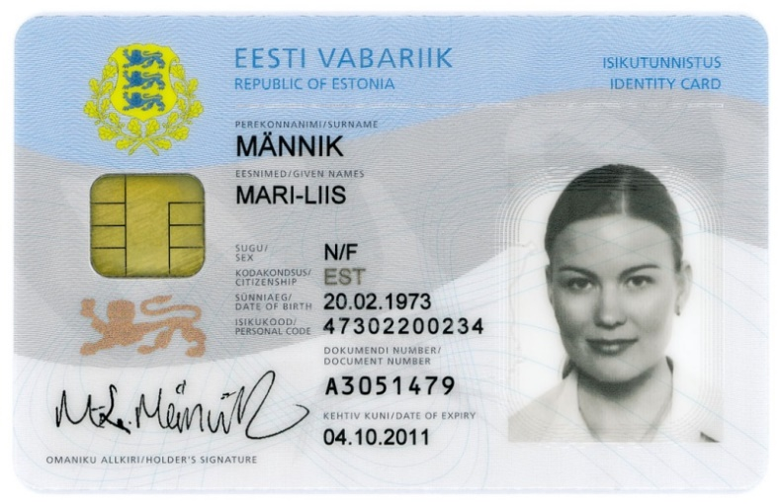
ID-card
ID card is ID + travel document. (Max. validity 5 years)
Contains:
  Visual personal information
  Personal data file
  Certificate for authentication
  (e-mail address)
  Certificate for digital signature

Slide 43
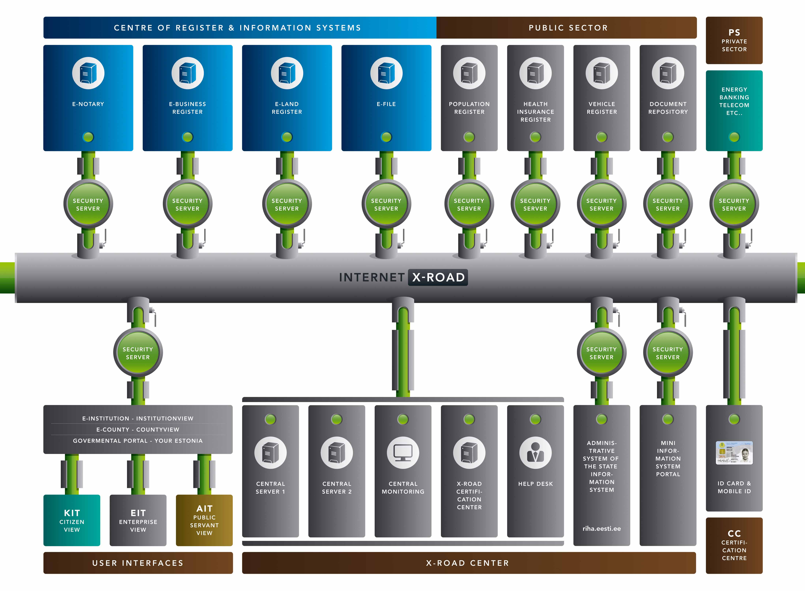

Slide 44
e-Business Register

Slide 45
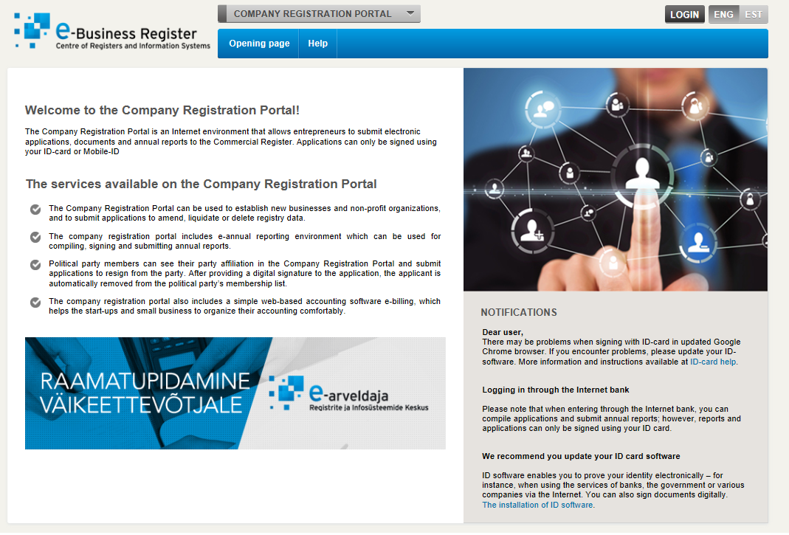

Slide 46
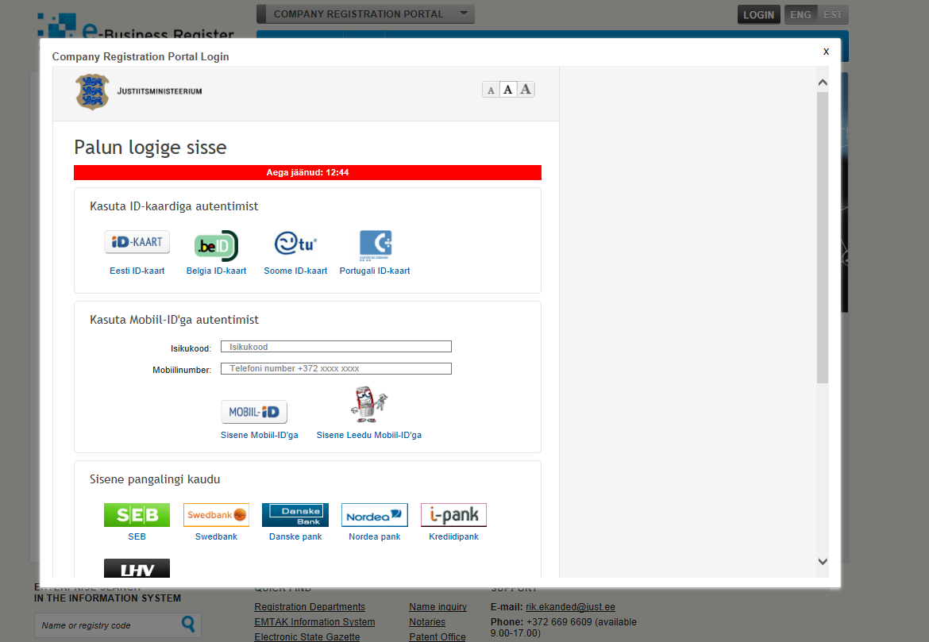

Slide 47
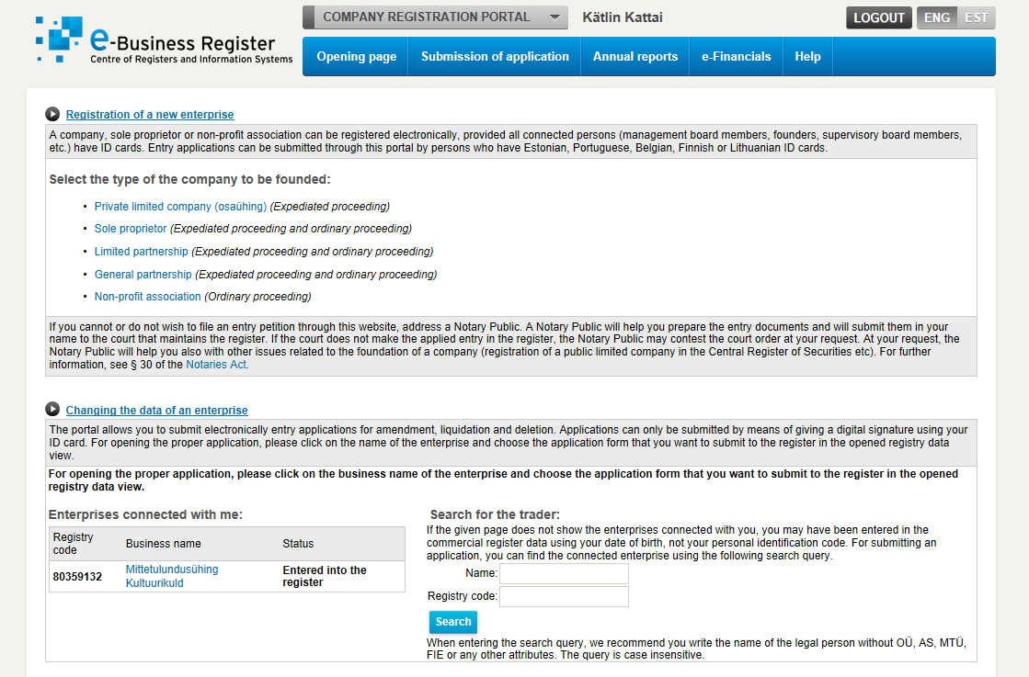

Slide 48
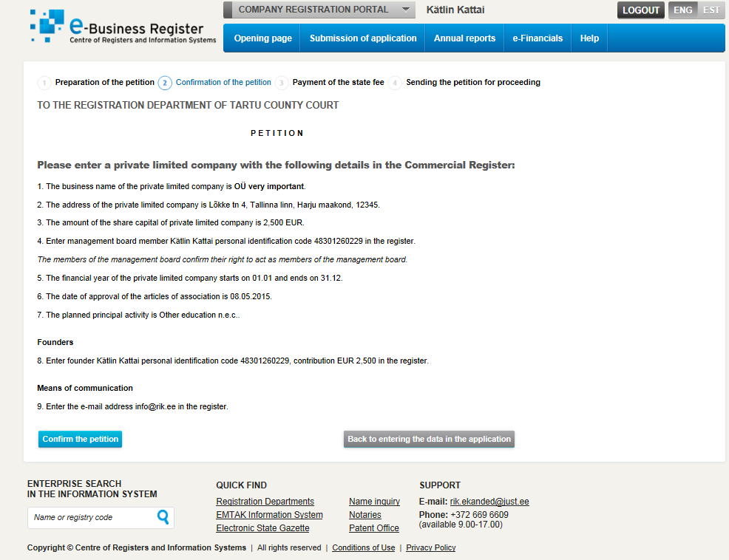

Slide 49
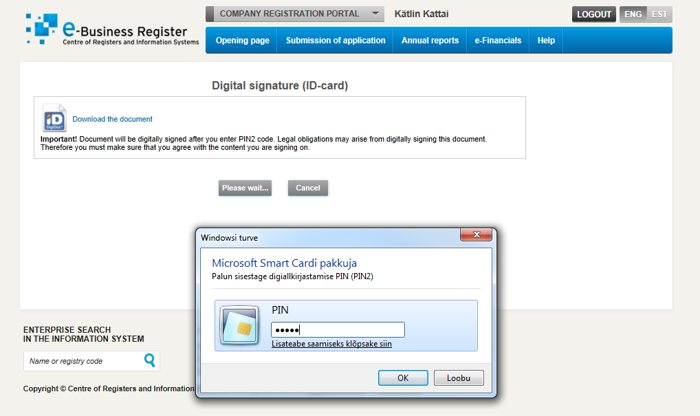

Slide 50
Challenges of digitalization directive (EU) 2019/1151
Trust cross-border electronic identification
Disqualified directors

Slide 51
Thank you!
Kai Härmand
Kai.Harmand@just.ee

Slide 52



20 min’
Coffee break
with the kind participation of

Slide 53
Panel I
Gabriela Fierbinţeanu
    Company Law Attachée, Permanent Representation of Romania to the EU, former Chair of the Council of the EU Working Party on Company Law, Assistant Professor in Commercial and Civil Law, Nicolae Titulescu University, Faculty of Law, Bucharest
Shareholders’ Protection in cross-border mobility of companies, and harmonised rules after the company law package
#CCBEconference2019
#EUCompanyLaw

Slide 54
Shareholders’ Protection in cross-border mobility of companies, and harmonised rules after the company law package
Gabriela Fierbinţeanu

Slide 55
Introduction
On 25 April 2018 the European Commission adopted the "Company Law package", which consists of two proposals for Directives amending Directive (EU) 2017/1132, the Directive as regards the use of digital tools and processes in company law ('digitalisation') and Directive as regards cross-border conversions, mergers and divisions ('mobility').

Slide 56
Introduction
"The initiative will safeguard rights of minority shareholders when companies carry-out cross-border operations. The initiative will focus on the protection of minority shareholders by providing them with adequate rights which can be easily exercised, in some cases without engaging administrative or judicial authorities. Minority shareholders will benefit from the harmonised rules by enjoying the same level of safeguards in all Member States “
(COMMISSION STAFF WORKING DOCUMENT IMPACT ASSESSMENT Accompanying the document Proposal for a Directive of the European Parliament and of the Council amending Directive (EU) 2017/1132 as regards the use of digital tools and processes in company law and Proposal for a Directive of the European Parliament and of the Council amending Directive (EU) 2017/1132 as regards cross-border conversions, mergers and divisions)

Slide 57
Shareholders’ Protection
Right to be informed on a planned cross border operation
  Information and documents available
  Information during general meeting

Slide 58
Shareholders’ Protection
General meeting approval of the draft terms of the cross border operation
Voting on draft terms of merger and of the articles of association
Necessary majority

Slide 59
Shareholders’ Protection
  Court’s control of the cross border procedure
  Court’s control of the share exchange ratio
  Shareholders rights:
  + payment in cash (shares and cash compensation)
  + exit right
  + minority members who have opposed the cross-border operation

Slide 60
Shareholders’ Protection.Current legislation
  The duration of the period when minority shareholders can request protection varies (from 10 days to 3 months) and so does the substance of the protection. In most Member States minority shareholders have a right to sell their shares against adequate cash compensation (so-called "exit rights").
  Some Member States offer also a right to additional cash compensation if the share exchange ratio is not adequate or a right of investigation, and/or additional procedural safeguards (e.g. a 75% majority is required in the general meeting to approve a cross-border merger, e.g. in the UK, Ireland, Germany).

Slide 61
Shareholders’ Protection. Current legislation
it can be questioned whether the approach in the existing CBMD (no substantive harmonisation) hampers the effectiveness of the existing regime. Taking into account that a minority shareholder can own up to nearly half of the shares of the company, the protection regime can be very costly and requires capital reserves if compensation has to be paid, which illustrates the importance of this element for carrying out a cross-border merger.

Slide 62
Shareholders’ Protection. Current legislation
business-related stakeholders regarded minority shareholder protection as a concern in cross-border mergers. In this context, stakeholders stated that if issues such as potential minority shareholders invoking protections are not rectified in advance, the merger will not be carried out because it would involve too many uncertainties. 65% of respondents who expressed an opinion were in favour of harmonising the rights of minority shareholders.

Slide 63
Shareholders’ Protection.Room for improvement
Shareholders who did not vote for the cross-border mergers or have no voting rights need to have the right to exit the company (dispose of their shares) and receive the adequate compensation. Member States should also ensure that shareholders of the merging companies who did not oppose the cross-border merger, but who considered that the proposed share-exchange ratio was inadequate may challenge that ratio before a national court.

Slide 64
Shareholders’ Protection.Room for improvement
Member States should ensure that shareholders of the merging companies who did not oppose the cross-border merger, but who considered that the proposed share-exchange ratio was inadequate may challenge that ratio set out in the common draft terms of the cross-border merger before a national court.

Slide 65
Shareholders’ Protection.Adopted text
(12) To allow all stakeholders’ legitimate interests to be taken into account in the procedure governing a cross-border operation, the company should draw up and disclose the draft terms of the proposed operation

Slide 66
Shareholders’ Protection.Adopted text
(13)In order to provide information to its members and employees, the company carrying out the cross-border operation should prepare a report for them. The report should explain and justify the legal and economic aspects of the proposed cross-border operation and should include information about members right to exit the company.

Slide 67
Shareholders’ Protection.Adopted text
(14)The draft terms of the cross-border operation, the offer of cash compensation made by the company to those members who wish to exit the company and, where applicable, the share-exchange ratio, including the amount of any complementary cash payment included in the draft terms, should be examined by an expert who is independent from the company.

Slide 68
Shareholders’ Protection.Adopted text
(17)The lack of harmonisation of safeguards for members has been identified as an obstacle to cross-border operations. Companies and their members face a wide variety of different forms of protection leading to complexity and legal uncertainty. Members should, therefore, be offered the same minimum level of protection regardless of the Member State in which the company is situated.

Slide 69
Shareholders’ Protection.Adopted text
(18)As a consequence of a cross-border operation, members often face a situation whereby the law applicable to their rights changes because they become members of a company governed by the law of a Member State other than the Member State the law of which was applicable to the company before the operation.

Slide 70
Shareholders’ Protection.Adopted text
Member States should, provide for members holding shares with voting rights and who voted against the approval of the draft terms to have the right to exit the company and receive cash compensation for their shares that is equivalent to the value of those shares

Slide 71
Shareholders’ Protection.Adopted text
Member States should be free to decide to extend that right also to other members, for example, to members holding shares without voting rights or members who, as a result of a cross-border division, would acquire shares in the recipient company in proportions different from those they held before the operation, or to members for whom there would be no change of applicable law but for whom certain rights would change due to the operation.

Slide 72
Shareholders’ Protection.Adopted text
(19)Companies should be able to estimate, to the extent possible, the costs related to the cross ‑ border operation. Members should, therefore, be required to declare to the company whether they have decided to exercise the right to dispose of their shares. Members might also be required to indicate, whether they intend to dispute the cash compensation offered and claim additional cash compensation.

Slide 73
Shareholders’ Protection.Adopted text
(20)The calculation of the offer of cash compensation should be based on generally accepted valuation methods. Members should have a right to dispute the calculation and question the adequacy of the cash compensation before a competent administrative or judicial authority or a body mandated under national law, including arbitral tribunals.

Slide 74
Shareholders’ Protection.Adopted text
Member States should be able to provide that members who have declared their decision to exercise the right to dispose of their shares are entitled to join such proceedings. Member States should also be able to establish time limits in national law for joining those proceedings.

Slide 75
Shareholders’ Protection.Adopted text
(21)As far as cross-border mergers or divisions are concerned, members who did not have or did not exercise the right to exit the company should, nevertheless, have a right to dispute the share-exchange ratio. When assessing the adequacy of the share-exchange ratio, the competent authority should also take into account the amount of any complementary cash payment included in the draft terms.

Slide 76
Company law package
a reliable legal framework for cross-border divisions , conversions and cross-border mergers
possibility to use relevant digital tools
for relevant stakeholders (employees, creditors, minority shareholders and other third parties), strengthened protection in cross-border situations.

Slide 77
Thank You!
gabriela.fierbinteanu@rpro.eu

Slide 78
Panel I
Prof. Dr. Hans de Wulf
    Professor, Law School, Gent University
Loyalty voting and liquidity tests: national reforms challenging the traditional approach in EU Company Law?
#CCBEconference2019
#EUCompanyLaw

Slide 79
Member states have moved on, EU
The 2019 Belgian Companies Act
as an illustration of Europe-wide trends

Slide 80
Executive summary
Outside the realm of listed companies, the EU has/d lost the initiative in company law to member states
  This is not necessarily a bad thing
This has led to the weakening of some long-standing tendencies of EU company law:
  Focus on black letter rules to protect creditors
  Focus on equal treatment of shareholders
For private companies, we observe a move away from black letter creditor protection to a focus on directors’ duties, and “insolvenfication”
  Example: liquidity test
For listed companies too, “one size fits all” approach is abandoned
  Example: no action against multiple voting rights

Slide 81
Executive summary
These developments –namely increased flexibility, increased freedom of establishment, and increasing reliance on directors’ duties- are to be welcomed
The company law package is usefully trying to complement these developments by creating additional rules on cross-border “movement”
The EU should not try to develop anti-abuse rules
Nor should it engage in a futile atempt to harmonise directors’ duties
Rather, it could usefully harmonise conflict of laws rules on directors’ duties

Slide 82
Evolution of EU company law in very broad brushstrokes
1. harmonisation, initially to prevent Netherlands from becoming Delaware of Europe
  i.e. out of concern for creditor protection
  Creditor protection was paramount goal, not only in 2nd Directive, but also in conservative accounting directive and in 1st company law directive with its disclosure and its “Prokura doctrine” that intended to protect creditors
  Another feature of 2nd directive: equal treatment of shareholders in legal capital operations like capital increases; preemption rights safeguarded

Slide 83
Evolution of EU company law in very broad brushstrokes
2. end of 1980s: harmonisation, having become a goal in itself, stalls, for various reasons
3a. 1990s: EU gets involved in capital markets regulation and corporate governance of listed firms, but hardly any traditional company law initiatives
3b. Second half of ‘90s: ECJ steps in to give teeth to freedom of establishment for companies: Seghers/Centros to (2017) Polbud
  => trust in regulation by member state of origin enforced
    => this will not lead to much cross-border movement of firms, but will lead to “light vehicle competition” and to pressure on “real seat doctrine” (see below)

Slide 84
4. Turnof the millenium: a new wind?
Some success, on paper, with creation of supra-national forms: SE, European cooperative company
Insight at level of EU Commission: need to focus on cross-border aspects of company law:
  => cross border mergers
  Public takeover bids
Start of regular “Action plans”, and of more open public consultations and involvement of outside experts

Slide 85
Regulatory competition after Centros/übeersering?
Only brief “flash in the pan” of continental European entrepreneurs using UK Ltds to escape their domestic company law
But lasting impact: “flexibilisation” of private companies all the rage
  Netherlands, Italy, Belgium
  Many member states de facto abolish minimum capital for private companies, or (like e.g. Germany) create “light” form of private company
Real seat doctrine not abolished nor incompatible with EU law, but under pressure =>
  Germany switches to incorporation theory towards EU companies
  Belgium switches world-wide

Slide 86
Efforts by member states to make their company law more flexible all the more necessary because of failure of EU to adopt SUP-like vehicle
  Not for lack of trying
  But various member state coalitions defeat all efforts
This remains a pity: would have answered a real entrepreneurial need while giving the EU the opportunity to keep some control over creditor and shareholder protection rules => no need for anti-abuse rules

Slide 87
recent themes at national level/internationally and has the EU been involved?
Updating partnership law; no need for EU interference
Light vehicle competition => director’s duties and insolvenfication; see next slides
  Also “abuse” of corporate personality/limited liability ?
  Desire to enable digital company formation: EU has acted
Persisting problems with audit and executive remuneration: EU has acted
Shareholder activism (and perceived short termism?): see SRD II= bad EU reaction
shareholder value dogma: pendulum swings the other way => debates about corporate purpose, prominence of ESG themes, increased focus on diversity, increasing demands for (and rules on) non-financial disclosure

Slide 88
SRDII: good intentions, typically weak results
Largely tackles the right issues, but in an ineffective way :
Shareholder engagement generally:
  no empirical or other indications that there was a problem that needed solving and Directive contains no concrete measures (perhaps fortunately) nor incentives for asset managers to change their business model
  No definition of short termism and therefore no effective attack on it
Shareholder identification and enabling shareholder rights: mainly exhoration towards member states, left to practice (Euroclear etc.) to implement
RPTs: here EU could have truly raised the quality of national laws, but the watered down end-product leaves too many options to MS
Proxy advisors: mainly increase of irrelevant red tape

Slide 89
Company law package
Redeeming initiative by EU commission after years of relative inactivity
Dicussed by other speakers today
Member states, spurred on by Centros and its progeny, have not waited for EU initiatives
Belgian reform is an illustration of a wider trend,
  to replace black letter rules on creditor protection with a reliance on directors’ duties
  To move away from shareholder equality to a certain extent

Slide 90
Belgian company law reform of 2019
Emblematic of reforms throughout Europe:
Move to incorporation theory, worldwide application
  Direct reaction to ECJ cases on freedom of establishment
Legal capital abolished for private companies
  As part of “light vehicle competition”
  Illustrates move away from black letter creditor protection rules
  Balanced by increased focus on director’s duties:
    Formal Liquidity test
    Formal rules on wrongful trading
At level of shareholder protection, too, move from rules to standards and disclosure
  Eg more flexible rules on price of newly issued shares and on premeption rights, but duty imposed on board to explictly set out the implications of share issuance to shareholders

Slide 91
Creditor protection: directors’ (and shareholders’) duties instead of legal capital
One country after another abolishes legal capital or reduces it to minimum (for private companies)
  Not allowed for public companies by EU Directive
  But in many countries very few public companies
But does not imply worse situation for creditors:
  were not effectively protected by legal capital rules anyway
  Increased focus on directors and to certain extent shareholders

Slide 92
Belgian approach illustrates possibilities and difficulties
Duty to have sufficient starting capital
  Duty to explain and justify starting finance in “financial plan”
  Notaries check whether minimum content respected
Liability of founders for net debt if company becomes insolvent within 3 years because of manifestly insuffcient financial means
Subordination of shareholder loans? No. Courts may decide it on basis of tort law, but almost never do
  However, in Belgium, Netherlands and France (and perhaps elsewehere) frequent liability of parent companies and banks for extending loans in a manner which is misleading to other creditors

Slide 93
Liquidity test
Balance sheet test and liquidity test
Liquidity test has existed for years in New Zealand statute
Now also in Belgium and Netherlands; rejected in 2006 UK Companies Act, but now voices pleading in favour
In many countries something similar was accepted by courts, based on duty of care/general tort law
  But turning it into black letter law concentrates the mind

Slide 94
Liquidity test controversial => advisors tell people not to concvert their public companies (SA/NV) into private ones
Liquidty test: duty of board
  Evaluate over at least 12 months
  Written but non-public report <-> Netherlands => flight to Netherlands, but, Centros-like, all activities in Belgium ?
  External accountant, if there is one, has to check figures
Liability of shareholders, even if in good faith, for unalwful dividends

Slide 95
Belgian approach continued
Wrongful trading provision in Insolvency Act
  Not acting properly when insolvency is apparent
  Director liability for net debt
    Even if it pre-dates technical insolvency
Gross negligence contributed to insolvency=> personal director liability for net debt (also in Insolvency Act)
Provisions moved to Insolvency Act out of Kornhaas -considerations

Slide 96
Renewed focus on directors’ duties is commendable
Provided individual shareholders and creditors have standing to sue
  Problematic in many countries
  Insolvency trustees don’t like costly procedures with unpredictable outcome
One big drawback: it is not at all certain that judges won’t be plagued by hindsight bias
  Especially if director-shareholder has taken money out of the company within, say, a year before insolvency

Slide 97
Legal certainty for directors
Second big drawback of focus on directors’ duties: in an international context, it is not always clear which law will govern
I think it’s not very useful to try and harmonise substantive content of duties:
  Even if one succeeded in e.g. forcing every member state to introduce rules on wrongful trading, and identical ones, the interpretations by national courts are guarantueed to diverge
But directors need to know which law will govern their conduct
=> EU could usefully harmonise, even through Regulation, conflicts of laws rules

Slide 98
Illustration of uncertainty: Kornhaas
Mainly confirms what was already known
Good that it reminded people that even if you are governed by corporate law of X, insolvency law (and tax law) of Y, your head office, will apply
But the judgement, which is badly written even though the outcome is correct and desirable, has been construed too broadly by some commentators
  Argue that only rules affecting legal capital and company registration can violate FOE
  Some even argue that insolvency rules need not be tested against freedom of establishment as a matter of principle
  Such statements are clearly wrong

Slide 99
ECJ approach so far
Claim is an insolvency claim, governed by law of COMI, if
  Claim arises after insolvency
  Can (only) be brought by insolveny trustee
  Is based on a rule which deviates from general civil law
But these criteria do not always reflect legitimate expectations of directors
Difficulties illustrated by cases concerning actio pauliana (e.g. NK/BNPParibasFortis) or interface between tort law and insolvency (Holterman/Ferho)

Slide 100
Should be governed by lex societatis:
Liquidity test
Serious losses procedure
Typically Belgian rules on founder’s liability in case of insolvency within three years of incorporation

Slide 101
1share one vote
Another area where member states have moved on after EU inaction

Slide 102
The death of one share one vote ?
US: deviations, hence “dual class structues” have always been allowed
NYSE and SEC ried to turn the tide for a while, but lost the battle
Silicon valley firms want it
But now pressure for sunset clauses:
  Dual class may be necessary to convince founder to take firm public, but not afterwards
  Founder may have unique value for firm, but not when he become senile, and her children likely will not have same value to firm

Slide 103
The death of one share one vote ?
EU: during 20th century, 1S1V increasingly became the norm, outside Scandinavia
  Even where its was not mandated by law, pressure on listed firm to adopt it:
    Few firms listed in London adopted it
    In the Netherlands steady decrease of special voting rights arrangements
      But still flourishing possibility to cement control, e.g. through “stichting”, cf. also move of Fiat to Amsterdam
2006: McCreevy commission is convinced by both lobbyists and rational arguments not to impose it:
  Silicon valley and Asia allow it
  Necessary to make listing palatable to some founders
  Investors know what they buy into

Slide 104
Trendy new argument in favor of multiple voting rights
“loyalty voting rights are conducive to long term views”, useful in combating short termism
France had a loyalty voting system since 1966, amended through loi Florange; Italy and Belgium introduced one
Make no mistake: while system may have added benefits, reason it obtained political backing is desire to allow controlling shareholders to cement control on the cheap
  Eg. French Loi Florange: intended to make it easier for French state to have double voting rights: now default, except opt-out
    M. Becht: Number and circumstances of opt-outs is compatible with Coasian bargain

Slide 105
Italy: as a reaction of move of Fiat to Netherlands
  Outrage by institutional investors against possibility to introduce with simple majority
Belgium: defended with all the traditional arguments but success explained by wish of government to support already controlling shareholders
  Although Green Party, not seeing what the real purpose was, supported possibility to make adoption by companies easier, thus hoping to help combat short-termism
  Little reaction by institutional shareholders: some negative interviews in newspapers and a letter to the government of industry body but no serious lobbying

Slide 106
Belgian system
Double voting right = maximum
  Useful in system that alows non-voting shares (cf. Snap) ?
For every shareholder who meet conditions (no special class of shares for some)
Condition: having been registered as holder of the shares for at least two years, without interruption
Loss of 2nd vote if shares are transferred
  Also: change of control over legal persons who holds them
Company needs to opt-in with 75% majority
  But temporarily 66%
Opt-in possible after listing !
  Otherwise it would not have been useful for existing controlling shareholders
In principle neglegcted for calculation of 30% mandatory bid treshold

Slide 107
conclusion
EU has regained the initiative with its company law package
But for non-listed companies, member states have irrevocably moved on, and away from traditional EU approach
  spurred on by ECJ cases on FOE
  But also by inaction at EU level
The more flexible company law that relies more on directors’ duties than on black letter rules that has resulted from this is to be welcomed
EU should not embark on the hopeless task of formulating anti-abuse rules, which will only undermine the internal market and will likely be incompatible with the Treaty
But it could usefully clarify the conflicts of law rules for directors’ duties: battle between insolvency and company law

Slide 108
60 min’
Enjoy your lunch break!

Slide 109
Panel II
  The Future of European Company Law
Moderator: Bart De Moor
Vice-President of the Dutch-speaking Bar of Brussels
#CCBEconference2019
#EUCompanyLaw

Slide 110
Panel II
Maija Laurila
    Head of the Company Law Unit, European Commission, DG for Justice and Consumers
New Commission mandate – what is in the air in company law and corporate governance?
#CCBEconference2019
#EUCompanyLaw

Slide 111
Panel II
Béatrice Richez-Baum
    Director General, ecoDa
Future Proposals for directors’ duties
#CCBEconference2019
#EUCompanyLaw

Slide 112


Director’s Duties Proposal
Béatrice Richez-Baum, Director General, ecoDa

Slide 113
Context: Companies are now facing
quasi-unlimited liability
No longer constrained to their role of economic agents, companies are now expected to create a new social order

Slide 114
What are the consequences in terms of Corporate Governance?

Slide 115

What are the consequences in terms of Corporate Governance?
Well-controlled enterprises no longer mean well-run businesses.
Towards a more board-centric form of corporate governance:
Criticism of shareholders (professionalization of asset management < > activists) and management (managerial opportunism)
Spotlight on boards as a consequence

Slide 116
Refocusing of directors’ duties
Historically, board of directors are considered as the fiduciary of the shareholders

Slide 117

Refocusing of directors’ duties: New developments
New: Business Roundtable statement: it puts customers, employees, suppliers and communities on the same level as shareholders
USA
New provision in complement to Section 172 (Company Law Act): large companies now have to include a new statement on how directors have considered stakeholders’ interests in their strategic reports
UK
New: Accountable Capitalism Act: it requires very large corporations to obtain a federal charter that demands that directors consider the interests of all corporate stakeholders.
USA
New § 1833 of the Civil Code: “the company is administered in the corporate interest, and taking into account the environmental and social considerations at stake”.
France

Slide 118
Refocusing of directors’ duties: prerequisites
Boards should not have unfettered authority
The Corporate Purpose as a safe harbor for directors – Beyond Business Judgment Rule.
Shareholders should be obliged to define the corporate purpose in the bylaws.
1
Not all stakeholders are on an equal footing
Not all stakeholders are equally important (depending on the sector).
2

Slide 119
Conclusions/ Take-aways:
Boards have to exercise more proactive oversight;
They have to strengthen their understanding of risk and opportunities affecting company performance;
They need to build reliable information networks.

Slide 120
Panel II
Dr. Birgit Spiesshofer M.C.J. (NYU)
    Of Counsel, Dentons, Berlin; Adjunct Professor for International Economic Law and Business Ethics, University of Bremen
Sustainable corporate governance
#CCBEconference2019
#EUCompanyLaw

Slide 121
Sustainable corporate governance
Dr. habil. Birgit Spießhofer M.C.J. (New York Univ.)
Conference on the „Modernization of European Company Law“
Council of Bars and Law Societies of Europe
Brussels 27 November 2019

Slide 122
1. The end of capitalism as we know it?
US-Business Roundtable "Statement on the Purpose of the Corporation", signed by 181 CEOs (August 19, 2019)
Larry Fink, Blackrock, Letter to the CEOs, WEF 2018:
"To prosper over time, every company must not only deliver financial performance, but also show how it makes a positive contribution to society. Companies must benefit all of their stakeholders, including shareholders, employees, customers, and the communities in which they operate."

Slide 123
2. Sustainability in Corporate Governance Codes
German Corporate Governance Code 2019
Austrian Corporate Governance Code
Dutch Corporate Governance Code
German National Action Plan on Business and Human Rights
(2016-2020)

Slide 124
3. Relationship of Corporate Governance
and
Compliance
Corporate Social Responsibility
Corporate Citizenship

Slide 125
4. Key elements of sustainable corporate governance
Longtermism
Stakeholder value and engagement
Corporate Social Responsibility / ESG (Environment, Social, Governance)

Slide 126
5. Standard-setters and -enforcers
NGO
(local, international)
IGO
(UN, OECD)
EU
state
investors
Enterprise
export agencies
financiers
industry
associations
private standard setters (ISO, IdW)
rating agencies
contract partner
(suppliers, clients, lawyers)

Slide 127
6. Sustainable Investment
Institutional Investor Aviva:
"Public policy makers have traditionally tended to focus on the flow of aid when considering traditional sustainable development issues. However, we believe that considering how the tens of trillions of private capital are located matters far more than how the tens of billions of dollars of official assistance get dispensed.
We see the primary failure of the capital markets in relation to sustainable development as one of misallocation of capital. This, in turn, is a result of global governments' failure to properly internalise environmental and social costs into companies' profit and loss statements. As a consequence the capital markets do not incorporate companies' full social and environmental costs. (...) The consequences of this are that unsustainable companies have a lower cost of capital than they should and so are more likely to be financed than sustainable companies."

Slide 128
6. Sustainable Investment
Responsible Investment Approach
(e.g. UN Principles for Responsible Investment)
- Negative screening
- Active ownership
- "Where consistent with our fiduciary responsibilities":
  EU Commission Report Resource Efficiency and Fiduciary Duties of Investors 12/2015:
  "It is clear that the integration of environmental factors in the investment policies and
  decision- making process of institutional investors is compatible with the existing legal framework related to fiduciary duties in all jurisdictions across the EU - as long as it is relevant to financial returns and the management of risk."

Slide 129
6. Sustainable Investment
European Commission Legislative Proposals on Sustainable Finance (May 2018)
- 180 billion EUR per year necessary to achieve EU climate targets by 2030
  > enterprises have to become more sustainable, investors have to
  use their leverage
- What is a "sustainable investment" and what are the constituent
factors?
- Is taxonomy the solution ?

Slide 130
7. Outlook
Clear direction: Towards more sustainable corporate governance!
But: the devil is in the detail.

Slide 131
Thank you!
Dr. habil. Birgit Spiesshofer M.C.J. (New York University)
Dentons Europe LLP
Markgrafenstraße 33
10117 Berlin
Germany
Dentons is the world's largest law firm, delivering quality and value to clients around the globe. Dentons is a leader on the Acritas Global Elite Brand Index, a BTI Client Service 30 Award winner and recognized by prominent business and legal publications for its innovations in client service, including founding Nextlaw Labs and the Nextlaw Global Referral Network. Dentons' polycentric approach and world-class talent challenge the status quo to advance client interests in the communities in which we live and work. www.dentons.com.
© 2017 Dentons. Dentons is a global legal practice providing client services worldwide through its member firms and affiliates. This publication is not designed to provide legal or other advice and you should not take, or refrain from taking, action based on its content. Please see dentons.com for Legal Notices.

Slide 132
Panel II
Karsten Engsig Sørensen
    Professor, Law Department, School of Business and Social Sciences, Aarhus University
Group corporate governance
#CCBEconference2019
#EUCompanyLaw

Slide 133
Group corporate governance

Slide 134
Status
  The failed negotiations on a 9th Company Law Directive
  2003 Action Plan
  The 2011 Reflection Group proposes recommendations recognising the interest of the group and more transparency
  Endorsed by the Commission in the 2012 Action Plan: European Company Law and Corporate Governance
  Several proposals, including two from the Informal Company Law Expert Group (ICLEG), but none from the Commission

Slide 135
Why is group Governance an issue?
  Group governance is a good thing
  National law on group governance differs, and as a result
    it may not always be clear to the management of the parent company (P) to what extent they can govern its subsidiaries (S) and what the consequences may be if they do so
    it is unclear to the management of the S to what extent they may act in the interest of the group (as opposed to the interest of S)
  Need for ‘safe harbour’ rules for both groups of managers and thus rules that enhance the flexibility of group management
  Already extensive body of rules that ensure transparency on different aspects of groups, but there are loopholes

Slide 136
Different focuses – different issues
P
Top-down
Bottom-up
S

Slide 137
How to ease group governance
  ICLEG proposal:
    Member States should allow management of S to take account of the interests of other companies in the group when they take decisions (recognising the interest of the group)
      What does it mean to ‘take account of’?
      Does it free management of S from potential liability if management does so?
      Does it require management to consider the interest of the group?
      Should management of S follow instructions given by P?
    Possibly special regime on cash-pooling in groups and group management in financial institutions

Slide 138
How to protect stakeholders in S
  Creditors
    ICLEG: An action should not reduce a company’s net asset below what is necessary to make a distribution
    Possibly also introduce solvency test: may only take action if management has formed the opinion that the company will be able to pay its debts during the following six months
  Minority shareholders
    ICLEG suggests three alternatives
      Limit the rules to wholly-owned S
      Include partially owned S that has adopted articles to allow for group governance and introduce rules ensuring that no transaction is for grossly inadequate consideration (Rozenblum formula)
  Employees and other stakeholders?

Slide 139
What about the top-down focus?
  Not covered in the current proposals
  No regulation of the P’s duties and the duties of P’s management
    Should they manage or at least oversee their S?
    What are the duties of the P’s management when they govern their S?
  Do the stakeholders in P need protection?
  These topics are often inadequately addressed in corporate governance codes and solved differently in national company law

Slide 140
Conclusions
  Will the Commission make a proposal on group governance?
    If so, there are still many issues to resolve
  May other actors address the issues?
    Most Member States seem reluctant, but CSR movement may change that
    Corporate governance codes could address this issue (more than now)

Slide 141
Thank you for your attention

Slide 142
Panel II
Christophe Clerc
    Lawyer, Descartes; Professor, Sciences Po, Paris
The prospects of corporate governance
in Europe
#CCBEconference2019
#EUCompanyLaw

Slide 143
Panel II
Dr. Antigoni Alexandropoulou
    Chair of the CCBE Company Law Committee; Assistant Professor, European University Cyprus; Lawyer (Greece)
Letter Box Companies:
Abuse of companies and freedom of movement in European Company Law
#CCBEconference2019
#EUCompanyLaw

Slide 144

CCBE Conference
“Modernisation of European Company Law”
Conclusions
With the kind participation of:
#CCBEconference2019
#EUCompanyLaw

Slide 145




