Slide 1
Company law: a European model
CCBE Conference
27 November 2019
Palais de Justice, Bruxelles
Christophe Clerc, Sciences Po Paris, Descartes Legal

Slide 2
Proposition
PROPOSITION: There is a European model for companies.
This is:
- A model
- A European model
- A well-functioning (albeit imperfect) model.
SOURCE: 2019 report for the International Labour Organisation (ILO)
Two authors: Olivier Favereau for the economic study, Christophe Clerc for the legal study

Slide 3
content
Foreword: the elephant in the room
I – By way of context: the triumph of shareholder primacy
II – Clearing the path: “interested parties” and investing parties”
III - By way of contrast: monistic models
A) Theoretical aspects
B) Real systems
IV - The European pluralistic model
A) Theoretical aspects
B) Real systems
Conclusion: fighting “for”, not “against”

Slide 4
The elephant in the room… Is a man
BOARDS: PROGRESS

Slide 5
The elephant in the room… Is a man
CEO’S: SHAME

Slide 6
CONTEXT: the triumph of shareholder primacy
Definition: ultimate power.
Examples: management decisions; takeover bids.
The rise of shareholder primacy:
UK in the 1960’s (TOBs) and in the 1990’s: Cadbury report; “corporate governance” codes; alignment of interest (stock-options)
US in the 1980’s (proxy advisor: ISS), the 1990’s (alignment of interest); the 2000’s (shareholder activists)
International expansion: EU legislation and OECD work

Slide 7
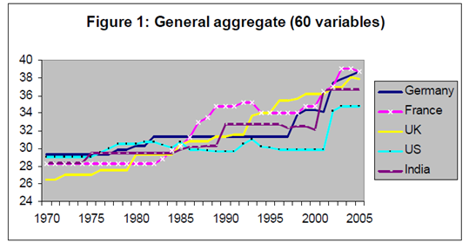
the triumph of shareholder primacy: the evidence (Lele & siems, 2007)

Slide 8
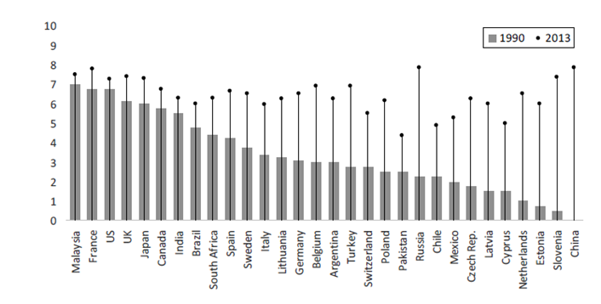
the triumph of shareholder primacy: deakins et al., 2017

Slide 9
Inequality of income (Top 10%) USA 1910 – 2010 Source: Piketty, 2013

Slide 10
Inequality of income (Top 1%) USA - UK 1910 – 2010 Source: Piketty, 2013

Slide 11
Inequality of income (Top 10%) USA - Europe 1900 – 2010 Source: Piketty, 2013
USA
EUROPE

Slide 12
Inequality in capital Europe – USA 1810 – 2010 Top 10% and Top1% Source : Piketty, 2013
Europe top 10%
Europe top 1%

Slide 13
Billionnaires in the world 1987 – 2013 Source : Piketty, 2013
1,5%
30
% of wealth
0,4%
Number of billionnaires per 100 M habitants
5

Slide 14
Clearing the path: who should seat at the board?
THE TRADITIONAL VIEW (since the 1980’s): SHAREHOLDERS vs STAKEHOLDERS
Source: a play on words
Concept: one category / all other categories
Interest: taking into account all stakeholders
PROBLEMS:
Symbolic: Equality between one category and all the others
Practical: Which stakeholders should be allowed to seat at the board?
Example: an environmental organization. Selection? Integration of company’s interest?
CONCLUSION: distinction is DATED and INEFFICIENT to address corporate governance issues.

Slide 15
Clearing the path: “INTERESTED PARTIES” AND “INVESTING PARTIES”
REFRESHED VIEW: “INTERESTED PARTIES” and “INVESTING PARTIES”
INTERESTED PARTIES:
Definition: All parties that are at risk because of the activity of the company
Examples: Shareholders, managers, employees, banks, suppliers, clients, subcontractors, communities, environment
INVESTING PARTIES:
Definition: All parties that are structurally investing in the company
List: Shareholders: invest money
Managers and employees: invest time (life) and competences

Slide 16
focus on the “INTERESTED PARTIES”
PRINCIPLE: NO representation at the board BUT other types of representation are important.
REPRESENTATION of INTERESTED PARTIES: AVOID “CUTE” MECHANISMS
“CUTE MECHANISM”: Representation of the interests of some “interested parties” by the management under the supervision of an external ad hoc auditor. Ex. B-Corps (or purpose-based companies).
FLAWS: The B-Corp defines the principles it needs to follow, defines the criteria to be monitored and selects and pays the auditor. Compare with students exams. Distinguish from financial auditors.
REPRESENTATION of INTERESTED PARTIES: SELECT “CORE” MECHANISMS
“CORE MECHANISM”: Ad hoc committees with (i) pluralistic selection process (involving management, employees and shareholders), (ii) means to act (budget) and (iii) rights to access relevant information and to disclose its opinion.
SCOPE: Representation by project or overall representation.

Slide 17
focus on the “INVESTING pARTIES”
INVESTMENTS: A contribution (something you bring in), a potential upside or downside on the value of the contribution and a return
CONTRIBUTION : Asset (material or immaterial), capacities and competences, span of limited lifetime
POTENTIAL UPSIDE OR DOWNSIDE:
Value of assets
Increase or decrease in capacities and competences (including potential natural decrease through ageing and increase through on-the-job training)
Loss of time
RETURN OVER THE LIFETIME OF THE INVESTMENTS:
Discounted cash flows coming from the investment: dividends and wages

Slide 18
monistic models: theory
PRINCIPLE: Each monistic model is based on a single value
EMPLOYEE - CENTRIC MODEL
PROS: Employees create the company wealth.
Involving employees in governance improves efficiency.
Democracy should not stop at the company front door.
CONS: Regular involvement of all employees may be time consuming
MANAGEMENT - CENTRIC MODEL
PROS: Managers need enough autonomy to manage properly
Managers are at the center of the creative process that defines companies (see MinesParisTech)
Managers have a role as “mediating hierarchs” (see Blair & Stout)
They are liable for their negligence (unlike shareholders whose liability is limited)
CONS: Unchecked authority may lead to self-serving practices

Slide 19
monistic models: theory of shareholder primacy
The OWNERSHIP MYTH:
Traditional claim: The shareholders own the firm (see Milton Friedmann)
Purpose: Make sure that shareholders, as “owners”, appear as natural holders of ultimate power
It is a myth: The firm is owned by the company.
Shareholders own shares – shares are not an ownership title (ownership is a legal concept).
No one “owns” a legal person.
The NEXUS OF CONTRACTS FALLACY
Claim: Legal personality is a fiction
Companies are only a “nexus of contracts” (Jensen & Meckling)
Purpose: No purpose, no liability towards society
Fallacy: Yes, legal personality is a fiction, but a useful one (same as contract or ownership)

Slide 20
monistic models: theory of shareholder primacy
The RESIDUAL CLAIMANT FAIRY TALE
Traditional claim: Shareholders are the party most at risk as “residual claimants” (their claim is contingent, others’ is fixed)
Reality: Risk is spread among all investing parties. For instance, regarding employees: loss of financial opportunities, physical risks (work accidents), loss of competences, loss of specific investments, loss of time
Consider status of investing parties when investing (information, risk division, timing) and divesting (timing, trial period, reputation)
The fairy tale: The leftovers of a Christmas dinner
The duty for legislators to protect the weak > the “GREAT UPENDING OF REPRESENTATIONS”

Slide 21
monistic models: theory of shareholder primacy
The dynamic of shareholder primacy
Crises: Each time there is a crisis (dot.coms, Enron, 2008, upcoming financial crash…) > single answer: strengthen shareholder power
Approach: “French cuisine”
Results:
Short-termism
Increase in financial activism
Increase in dividends and share buy-backs

Slide 22
monistic systems
SHAREHOLDER – CENTRIC : THE UNITED KINGDOM
Enlightened shareholder value … is putting shareholder value first
Legal supremacy of shareholders
Takeover bids
MANAGEMENT - CENTRIC MODEL : THE UNITED STATES (DELAWARE)
Authority norm: shareholders cannot deprive the board of its powers
Specific issues: by-laws, plurality voting, staggered boards, slates of candidates to the board, agenda setting, special meetings, dividends, capital increases, tender offers, poison pills…
Worked for almost all of the XXth century
But from the 2000’s: increasing influence of shareholder primacy
EMPLOYEE - CENTRIC MODEL
Employee ownership of shares: limited efficiency
Cooperatives: e.g. Mondragon

Slide 23
Pluralistic theory
KEY CONCEPT: CHECKS AND BALANCES
In companies, power matters
In the world, company power matters
“Power tends to corrupt, and absolute power corrupts absolutely” (John Dalberg-Acton)
HOW TO MANAGE CONFLICTING INTERESTS?
Done all the time, everywhere, in all institutions
Shareholder primacy doesn’t solve the issue: shareholders have conflicting interests (LT vs ST, activists vs family, etc.)
POSITIONAL RATIONALITY (Amartya Sen)
Three kids and a flute: Three rational solutions
Process: Reasonable and informed discussion between equal participants (board)

Slide 24
Pluralistic theory
CRITERIA FOR COUNTRIES WITH A PLURALISTIC COMPANY MODEL
There is not one perfect country
But all countries combine to a reasonable extent most significant criteria
Assessment method: reasonable review, not leximetry
TWO CONTEXT CRITERIA
Diversity of shareholder types: families (everywhere), non-financial institutions, foundations (Germany, Denmark, Sweden, …), States and sovereign wealth funds (Norway, France, Austria…), employees (France)
Protection of interested parties: laws on bribery, due diligence requirements on sub-contractors, labour law, non-discrimination against women, etc.

Slide 25
Pluralistic theory
FOUR GOVERNANCE CRITERIA
Company interest: The law doesn’t mandate that companies be run first in shareholders’ interest
Best when the law refers to “firm”, “company” or “constituent” interests
Shareholder rights: Must be sufficient to ensure a fair return on investment can be secured
Management rights: Sufficient autonomy must be secured (powers legally defined and protected, dismissal rules)
Employee rights: Board-level representation with appropriate protection
FOCUS ON BOARD-LEVEL EMPLOYEE REPRESENTATION
A European concept: Only in Europe. Invented in Germany (all companies) and France (State-owned companies). Extended in Northern Europe and (after the fall of Berlin Wall) in Central Europe. Exists in most European countries.
Distinctive criterion: No system may be pluralistic without BLER.

Slide 26
Pluralistic SYSTEMS: which countries?
SCANDINAVIAN COUNTRIES: DENMARK, SWEDEN, NORWAY, FINLAND
GERMAN SPEAKING COUNTRIES: GERMANY, AUSTRIA
OTHER COUNTRIES: THE NETHERLANDS, FRANCE (since 2013)

Slide 27
conclusions
SHAREHOLDERS PRIMACY is dominant, but THIS IS NOT THE END OF THE STORY
GET THE CONCEPTS STRAIGHT:
DROP the SHAREHOLDERS / STAKEHOLDERS distinction and ADOPT the more useful “INTERESTED PARTIES” / “INVESTING PARTIES” distinction
DROP “CUTE MECHANISMS” and go for “CORE MECHANISMS”
FORGET about the OWNERSHIP MYTH, the NEXUS OF CONTRACTS FALLACY and the RESIDUAL CLAIMANT FAIRY TALE
In a world of POSITIONAL RATIONALITY, consider that PLURALISTIC APPROACHES are more natural and work better than MONISTIC APPROACHES.
Consider the WORLD YOU WANT TO LIVE IN:
A “PROFIT – IS – KING” shareholder-centric world … a “BOSS – IS – KING” management-centric one
… or a “REGULATED PLURALISTIC” one?

Slide 28
contact
Christophe Clerc
Descartes Legal
c.clerc@descartes.law

